Slide 1
Introduction to Human Anatomy and Physiology

Slide 2
Anatomy – the structure of body parts (also called Morphology)
Physiology – the function of the body parts, what they do and how they do it

Slide 3
Life Processes
1) Movement - self initiated change in position, motion of internal parts
2) Responsiveness (irritability) - Ability to sense changes within, or around the organism and react to them
3) Growth - increase in body size
4) Reproduction - Parents produce offspring / producing new individuals
5) Respiration - Obtaining oxygen (O2), using it to release energy from food substances, and getting rid of wastes

Slide 4
6) Digestion - Chemically changing (breaking down) food substances, and getting rid of wastes
7) Absorption - Passage of Digested products (food substances) through membranes and into body fluids
8) Circulation - Movement of substances throughout the body
9) Assimilation - Changing absorbed substances into chemically different substances
10) Excretion - Removal of wastes

Slide 5
I am walking to Mcdonalds (movement)
I stop at the traffic light (response)
My body is growing (growth)
I am breathing air (respiration)
I get a hamburger and eat it (digestion)
My body absorbs the hamburger (absorption)
The hamburger circulates in my body (circulation)
The hamburger is changed to things my body needs (assimilation)
Eventually, I go to the bathroom (excretion)
Someday I may reproduce (reproduction)

Slide 6
Metabolism = all the physical and chemical changes
Bodily needs = food, oxygen, water, heat
Homeostasis = tendency of the body to maintain a stable, balanced, internal environment. “Sameness”

Slide 7
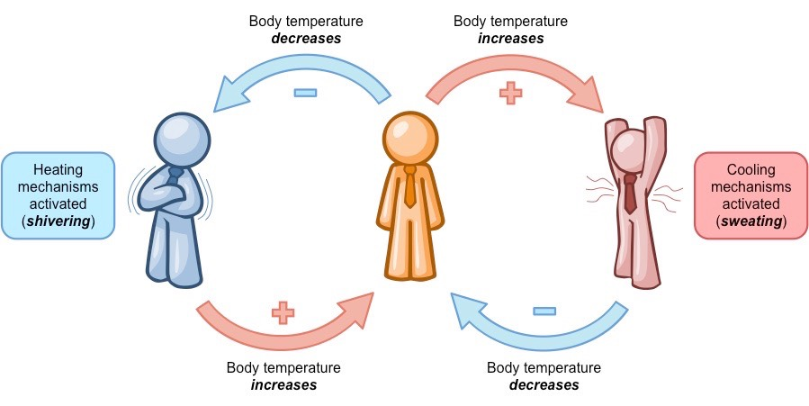
Negative Feedback
Negative feedback loop- process shuts off at some point, maintains homeostasis
Example- thermostat, maintaining body temperature

Slide 8
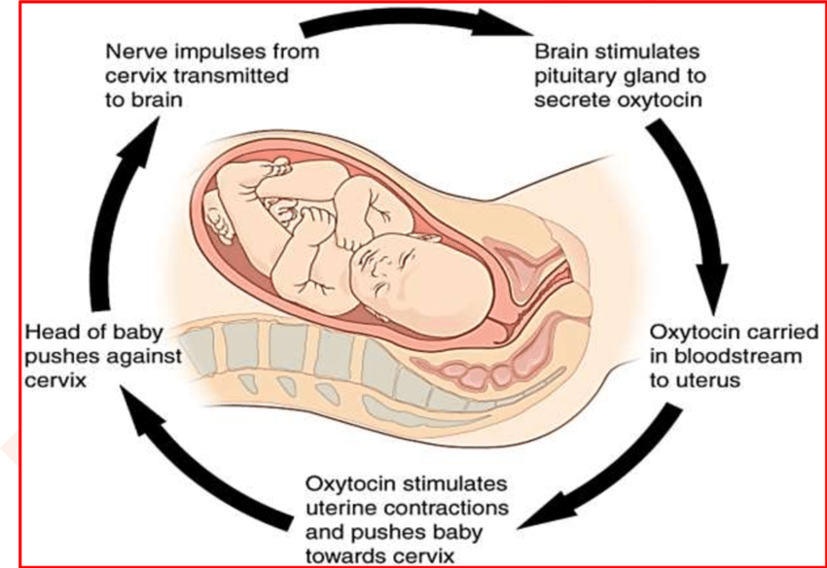
Positive Feedback
Positive feedback- no shut off, special situation in body
Example- childbirth, blood clotting

Slide 10
1) Axial Portion - head, neck, trunk
2) Appendicular Portion - arms & legs
3) Several body cavities 4) Layers of membranes within cavities 5) Variety of organs and organ systems within cavities (VISCERA = internal organs. "Visceral organs")

Slide 11
Body Cavities
Dorsal = back side
Cranial- contains brain
Vertebral- contains spinal cord
Ventral = front side
Thoracic = chest (heart, trachea, lungs..)
Abdomen = stomach area (spleen, intestines)
Pelvic = lower abdomen (bladder, reproductive organs)
Diaphragm= Separates the thoracic and abdominal region

Slide 14
It's easier to visualize the body cavities on pictures - see Body Cavity Label | Label 2
Label the body cavities (use your book)

Slide 15
Serous Membranes and Fluid
Serous Membrane - two layered, covers organs
Outer layer = parietal
Inner layer = visceral (lines the organs)
Serous fluid – lubricating fluid

Slide 16
Pleura = lungs
Pericardium = heart
Peritoneum = organs (abdominopelvic region)

Slide 17
Homework: Organ Systems Concept Map

Slide 18
Directional Terms
Anatomical Position = standing erect, face forward, arms at side, palms facing forward
*Study and learn the following terms*
1. Superior- towards the top
2. Inferior- towards the bottom
3. Anterior- towards the front
4. Posterior- towards the back
5. Medial- towards the midline
6. Lateral- away from the midline
7. Proximal- towards the limb attachment
8. Distal- away from the limb attachment
9. Superficial- towards the outside 10. Deep- towards the inside

Slide 19
Assignment: For each of the 10 directional terms on the previous slide, write a sentence comparing 2 body parts.
Example: The head is superior to the feet.

Slide 21
Homework: Fill out the chart on the body regions

Slide 22
There are tons of careers, some of them only require a short term of training. What are your goals?
See Explore Health Careers
Homework: Medical and Applied Science

