Slide 1
Axial Skeleton and Bone Fractures

Slide 2
Bone Fractures
A break in a bone
Types of bone fractures
Closed (simple) fracture – break that does not penetrate the skin
Open (compound) fracture – broken bone penetrates through the skin
Bone fractures are treated by reduction and immobilization
Realignment of the bone

Slide 3
Common Types of Fractures
Table 5.2

Slide 4
Repair of Bone Fractures
Hematoma (blood-filled swelling) is formed
Break is splinted by fibrocartilage to form a callus
Fibrocartilage callus is replaced by a bony callus
Bony callus is remodeled to form a permanent patch

Slide 5
Stages in the Healing of a Bone Fracture
Figure 5.5

Slide 6
The Axial Skeleton
Forms the longitudinal part of the body
Divided into three parts
Skull
Vertebral column
Bony thorax

Slide 7
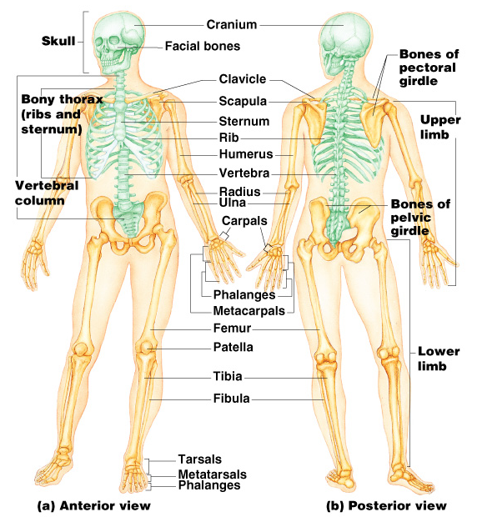
The Axial Skeleton
Figure 5.6

Slide 8
The Skull
Two sets of bones
Cranium
Facial bones
Bones are joined by sutures
Only the mandible is attached by a freely movable joint

Slide 9
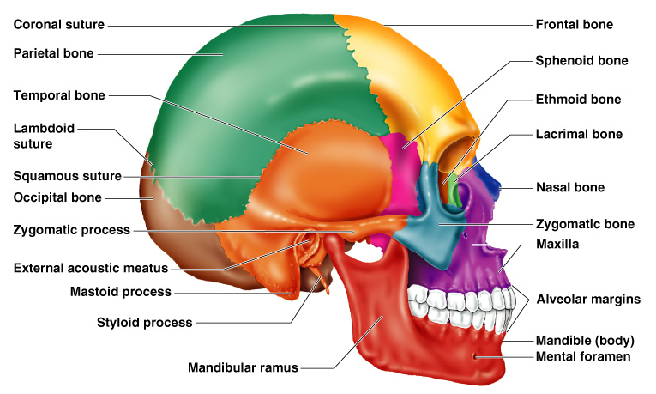
The Skull
Figure 5.7

Slide 10
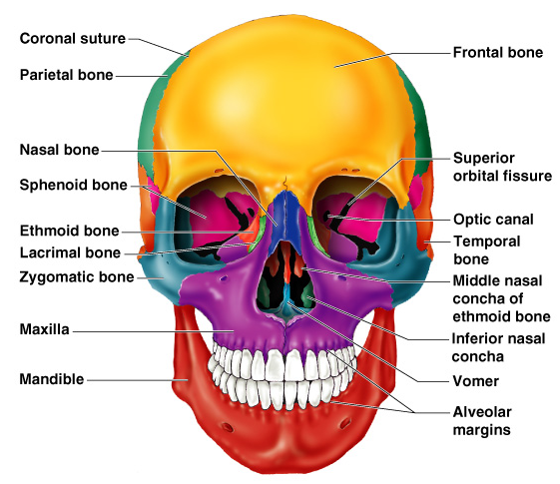
Bones of the Skull
Figure 5.11

Slide 11
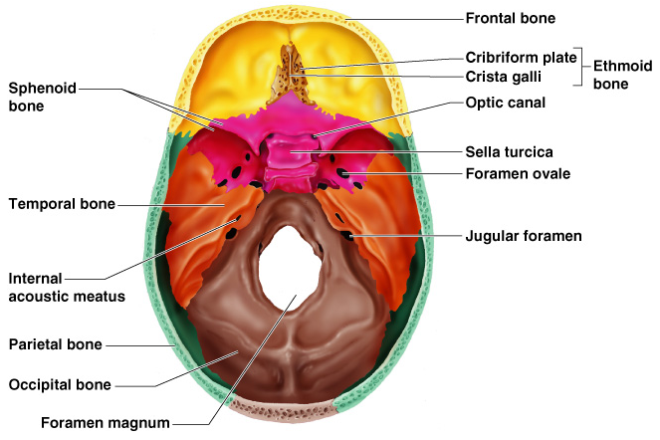
Human Skull, Superior View
Figure 5.8

Slide 12
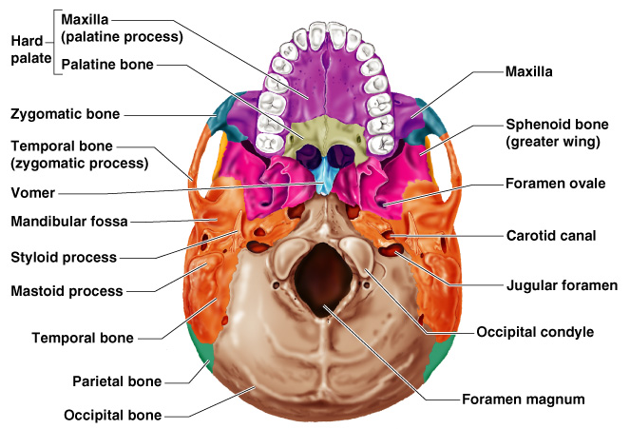
Human Skull, Inferior View
Figure 5.9

Slide 13
Skull Sutures

Slide 14
Paranasal Sinuses
Hollow portions of bones surrounding the nasal cavity
Figure 5.10

Slide 15
Paranasal Sinuses
Functions of paranasal sinuses
Lighten the skull
Give resonance and amplification to voice
Figure 5.10

Slide 16
The Hyoid Bone
The only bone that does not articulate with another bone
Serves as a moveable base for the tongue
Figure 5.12

Slide 17
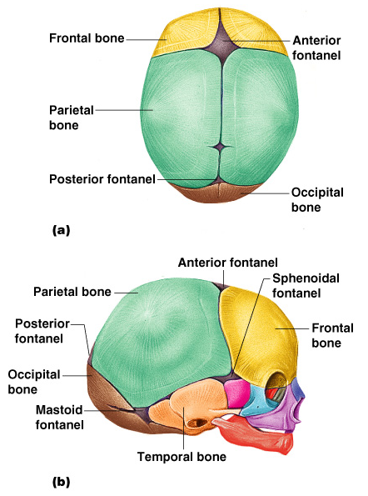
The Fetal Skull
The fetal skull is large compared to the infants total body length
Figure 5.13

Slide 18
The Fetal Skull
Fontanelles – fibrous membranes connecting the cranial bones
Allow the brain to grow
Convert to bone within 24 months after birth
Figure 5.13

Slide 19
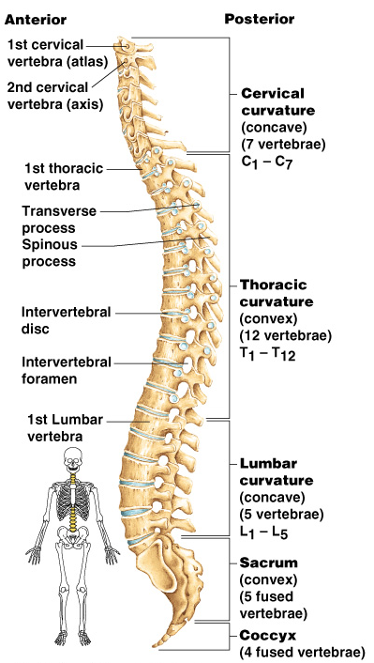
The Vertebral Column
Vertebrae separated by intervertebral discs
The spine has a normal curvature
Each vertebrae is given a name according to its location
Figure 5.14

Slide 21
Structure of a Typical Vertebrae
Figure 5.16

Slide 22
Atlas and Axis (Special Vertebrae)

Slide 23
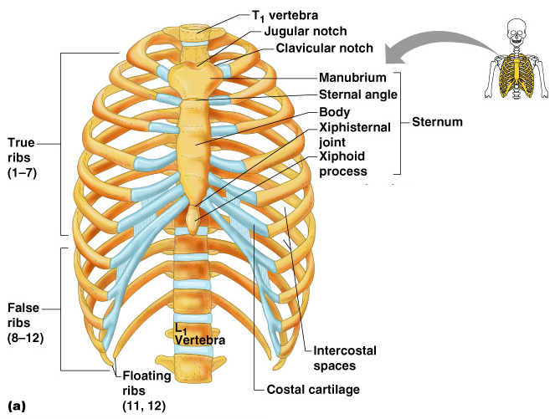
The Bony Thorax
Forms a cage to protect major organs
Figure 5.19a

Slide 24
The Bony Thorax
Made-up of three parts
Sternum
Ribs
Thoracic vertebrae
Figure 5.19a

