Slide 1
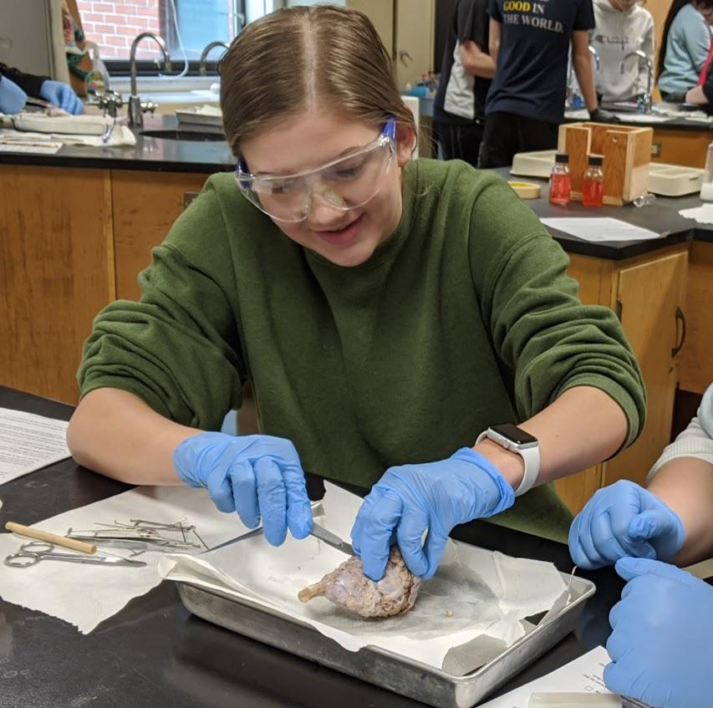
Brain Anatomy
Virtual Dissection and Guided Learning
In this activity, you will progress through slides with images and information about the brain and complete tasks, such as labeling and answering questions. This activity was designed as a remote version of a traditional brain dissection.

Slide 2
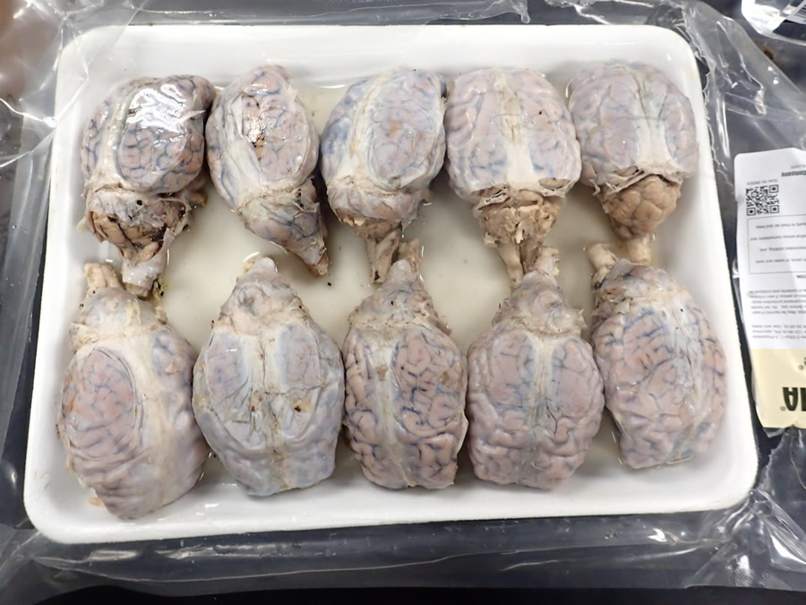
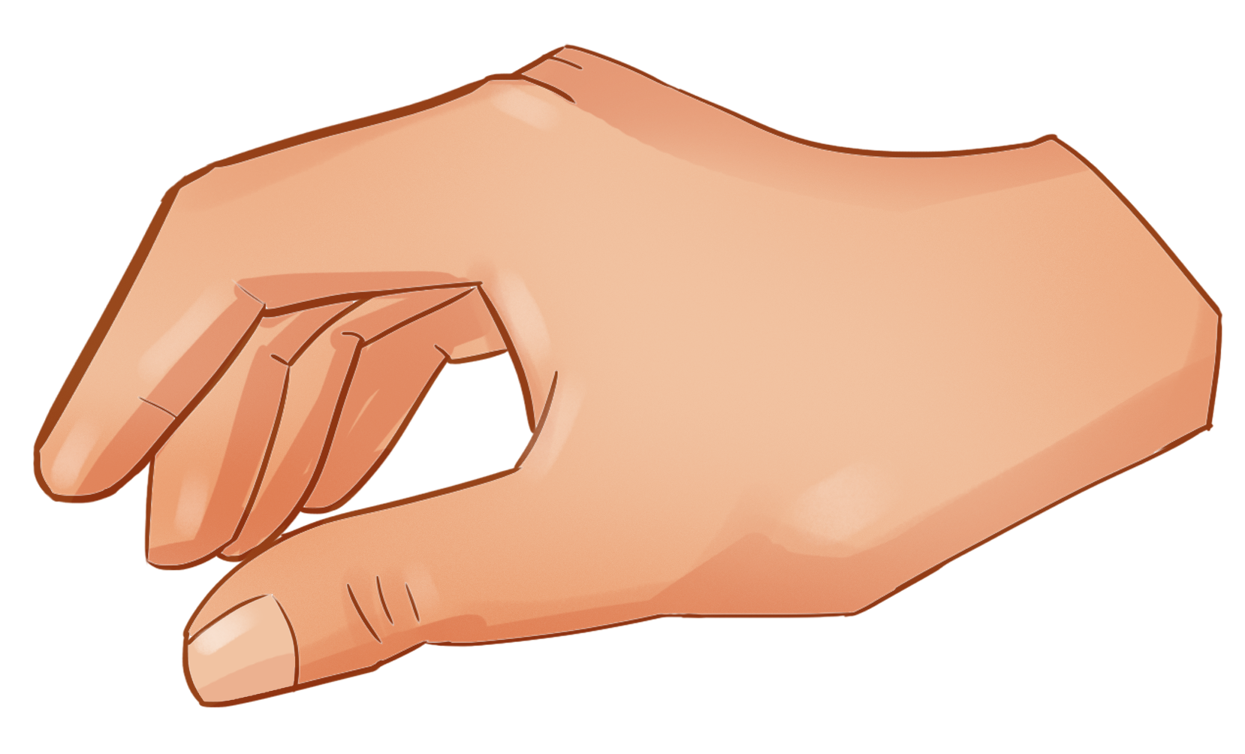
The specimen you will be learning from is a sheep brain. These brains are preserved and packaged before they are sent to the lab.
If you look closely at the packaged brains, you will notice that the brain is covered in a semi-transparent membrane. This is called the dura mater.
1. The first step in the dissection is to choose your brain and rinse it in the sink. Drag the hand to the brain of your choice.

Slide 3
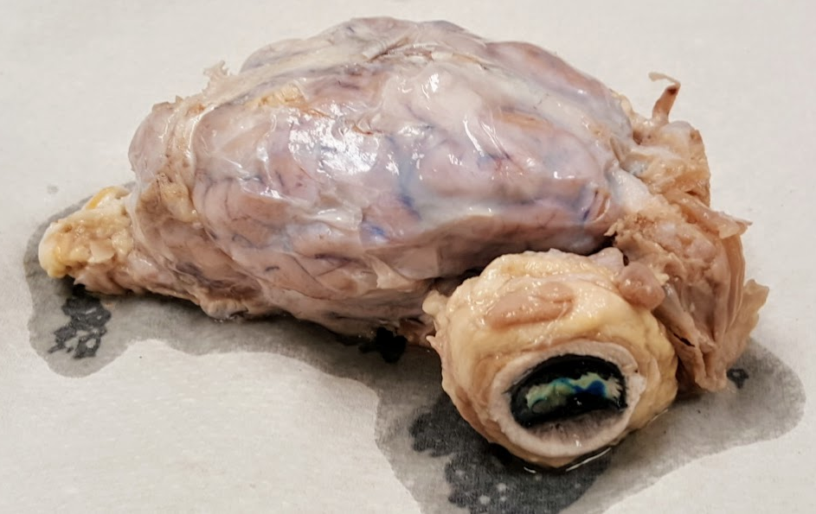
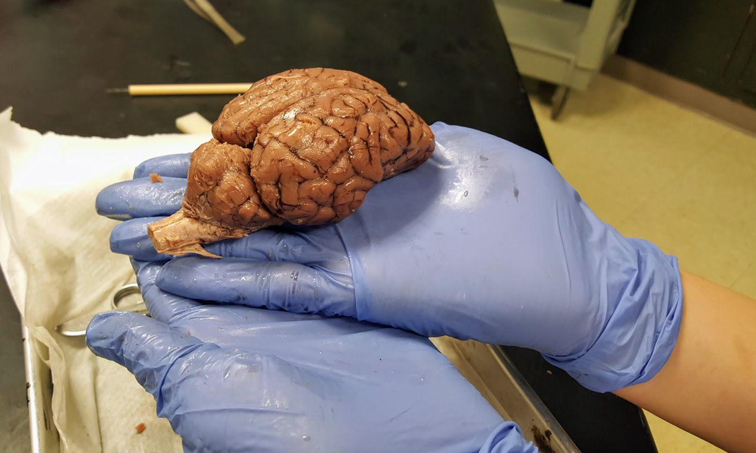
To view the external anatomy of the brain, the dura mater must be removed. It can be cut with scissors and carefully peeled away without damaging underlying structures.
In the specimen shown, the brain was shipped with the eye attached. The second image shows the brain with the dura and eye stalk removed.
2. Use the green arrow to indicate where you would cut to remove the dura mater.
Use the blue arrow to identify the sheep’s eye.

Slide 4
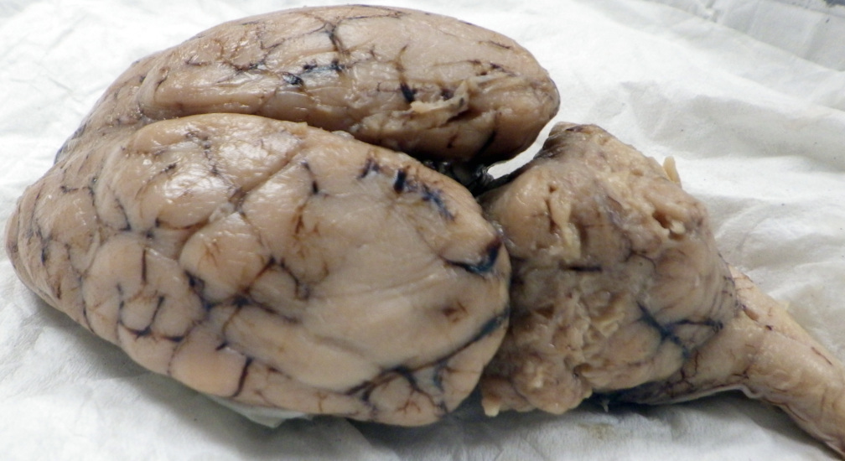
With the dura mater removed, you can now examine the external anatomy of the brain.
Note that the cerebrum is divided into two hemispheres, separated by the longitudinal fissure.
The cerebellum is only loosely connected to the rest of the brain with. The gap between the cerebrum and cerebellum is the transverse fissure.
Extending from the cerebellum is the brain stem.
3. Label the parts of the brain by dragging the labels to the area.
longitudinal fissure
cerebellum
brain stem
transverse fissure
cerebrum

Slide 5
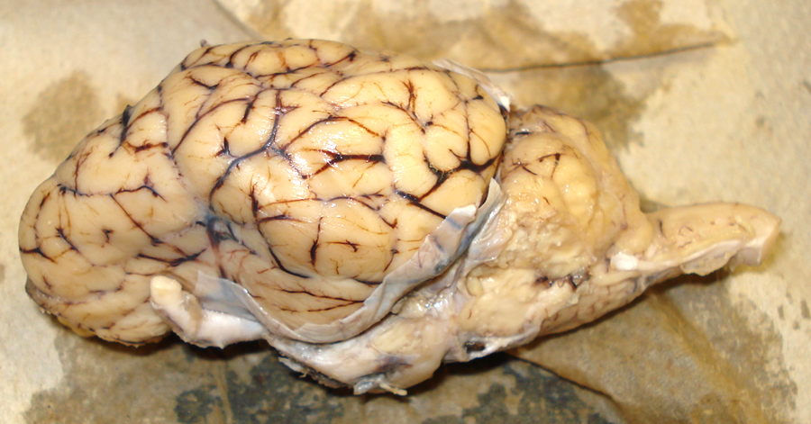
The cerebrum is the wrinkled area of the brain responsible for thinking and learning. The wrinkles are called gyri with the darker grooves called the sulcus.
Like humans, the cerebrum of the sheep brain is divided into regions called lobes.
The most anterior region is the frontal lobe.
The central most posterior region (closest to the cerebellum) is the occipital lobe.
The central area is the parietal lobe.
The temporal lobe is beneath the parietal lobe.
4. Drag the labels to the region of the brain.
occipital lobe
temporal lobe
parietal lobe
frontal lobe

Slide 6
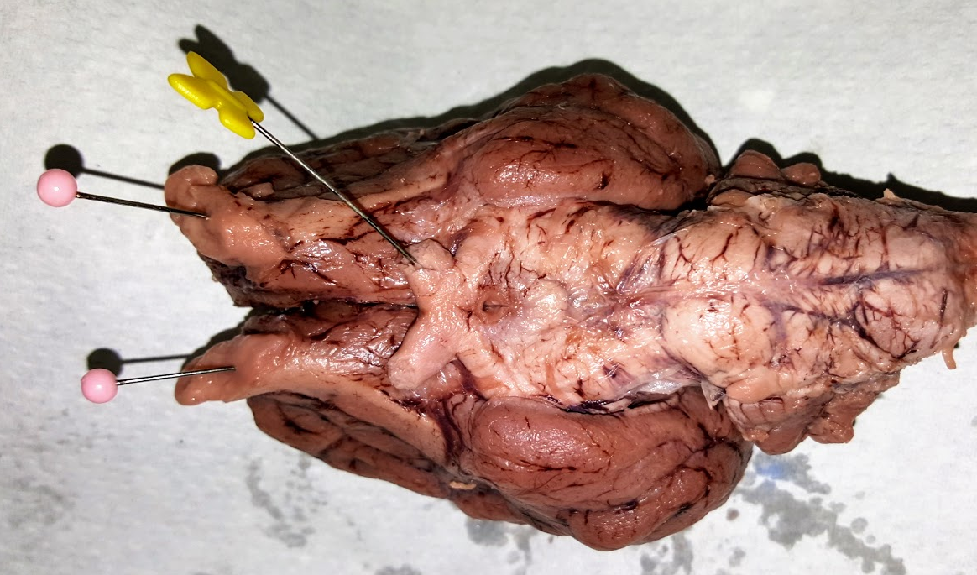
Turn the brain over to view features on the bottom of the brain. Two prominent nerves are visible in this image. The most anterior feature indicated with a pink pin is the olfactory nerve. It is responsible for the sheep’s sense of smell.
The yellow pin indicates the optic chiasma, or the place where the two optic nerves cross. Optic nerves lead to the eyes and transmit visual information to the brain.
5. Label the two nerves.
olfactory nerve
optic chiasma

Slide 7
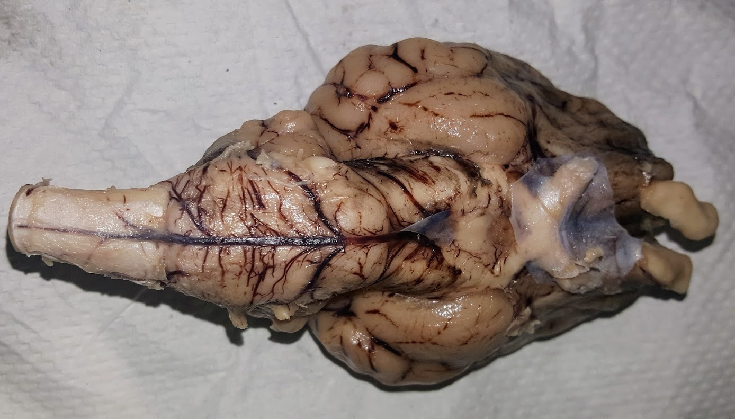
Just behind the optic chiasma, is an area called the infundibulum, which is where the pituitary gland is attached. This gland will not be present on the preserved brain.
Behind the infundibulum is a raised area called the mammillary body.
The brainstem is divided into three regions, the midbrain, pons, and medulla oblongata, which connects to the spinal cord.
6. Label the structures.
pons
midbrain
medulla
spinal cord
infundibulum
mamillary body

Slide 8
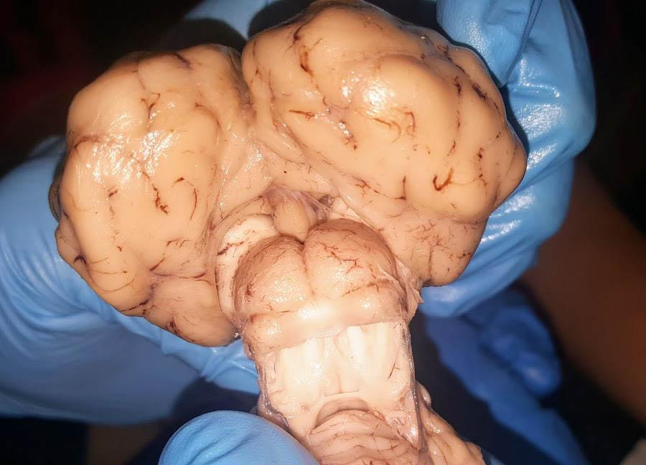
In the posterior region of the brain, you can view internal structures by pulling the cerebellum down and away from the cerebrum.
This will reveal the superior colliculus, which resembles a “butt” and the smaller inferior colliculus.
The superior colliculus is part of the brain circuit for sensory input into movement output. Its major function is orienting the animal, particularly with eye movements, to objects of interest.
Nestled just above the superior colliculus is a the pineal gland. It is responsible for regulating Circadian rhythms (sleep and wake cycles).
7. Label the structures.
Occipital lobe
of cerebrum
Cerebellum pulled down
superior colliculus
inferior colliculus
pineal gland

Slide 9
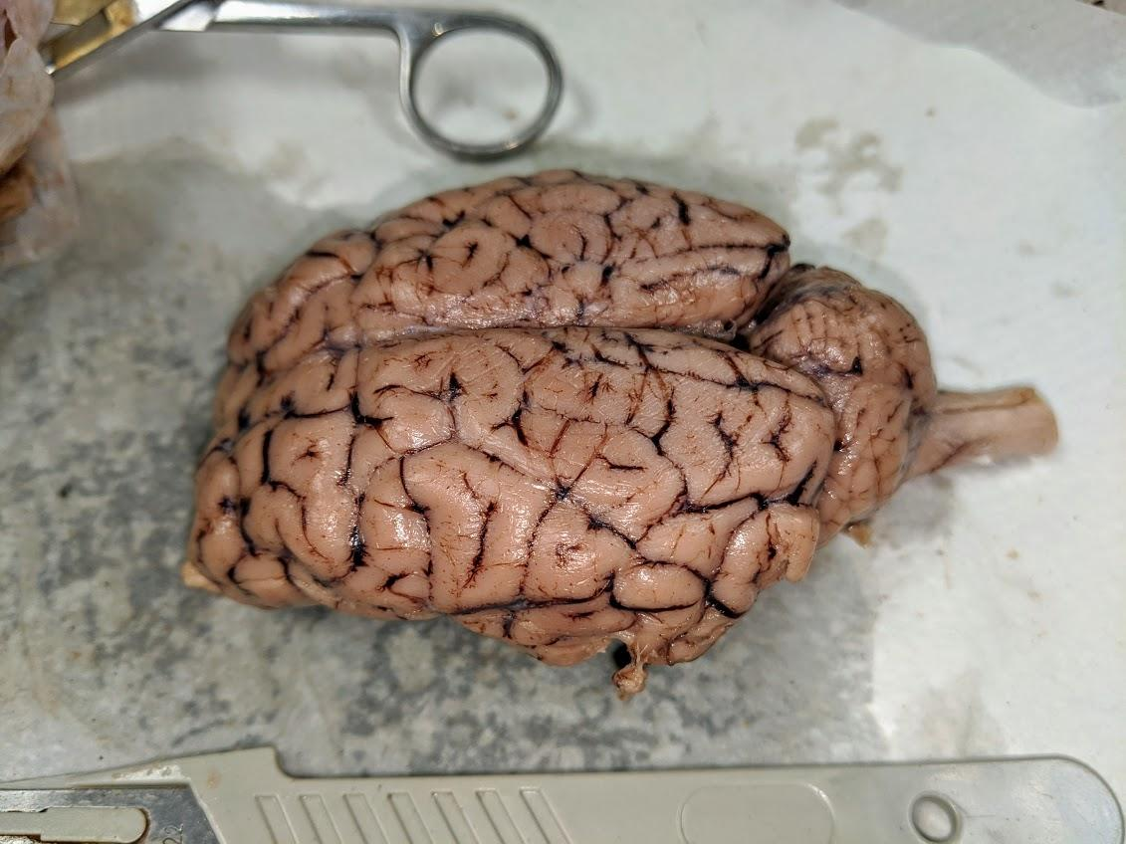
To view the internal structures of the brain, a scalpel is used to make an incision along the longitudinal fissure that will cut the brain into the left and right hemispheres, and also cut the cerebellum in half.
Brain tissue is soft and easy to cut through, though it can be difficult to get an exact cut to evenly slice the brain in half.
8. The scalpel in the image is showing a cut at what fissure?

Slide 10
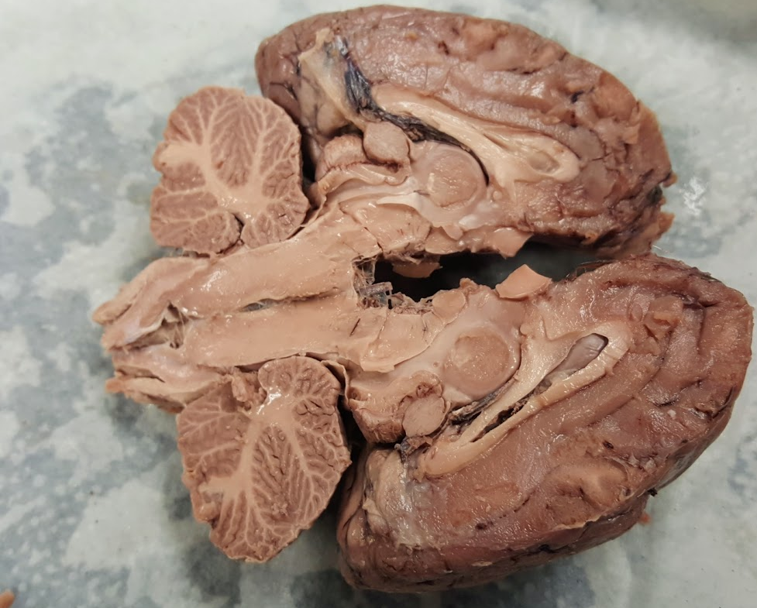
A perfect cut reveals the internal structures of the brain.
Notice that the cerebellum has branching white matter that resembles a tree. This structure is called the arbor vitae, or “tree of life.”
From this view, you can also identify where the brain stem ends and the spinal cord begins.
9. Label the image.
arbor vitae
spinal cord
brain stem
cerebellum

Slide 11
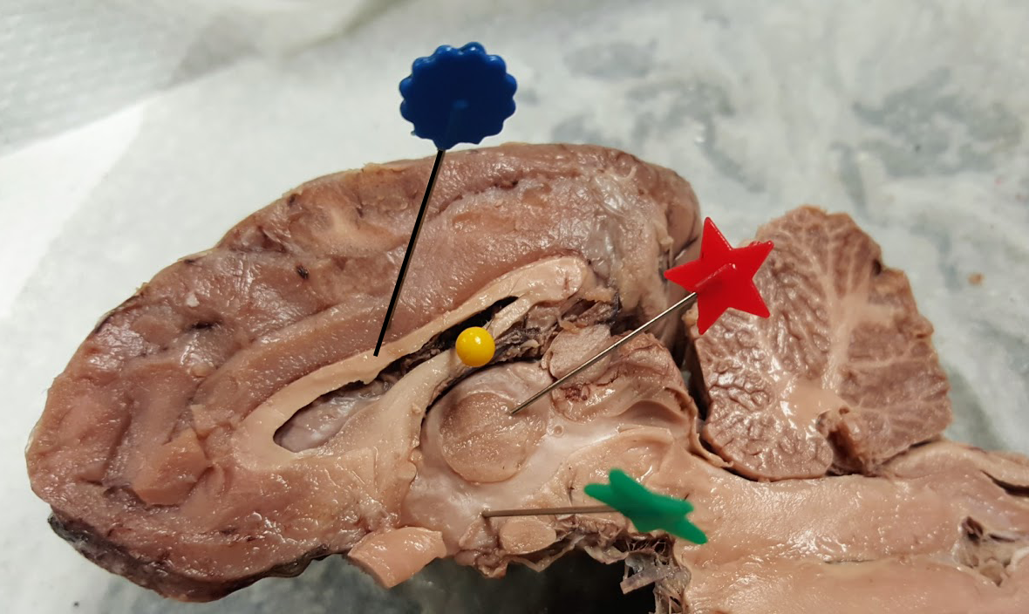
It is usually easiest to focus on one of the hemispheres to locate internal structures. In the image a few of the structures have been pinned.
The blue pin is the corpus callosum, which connects the left and right hemispheres.
The yellow pin indicates one of the ventricles of the brain where cerebrospinal fluid is stored. The yellow pin indicates the lateral ventricle.
The round structure at the red pin is the thalamus which relays sensory and motor signals.
Beneath the thalamus, at the green pin is the hypothalamus, which plays a role in energy maintenance, temperature regulation, and appetite. The hypothalamus connects directly to the pituitary gland.
10. Label the image (type in boxes).

Slide 12
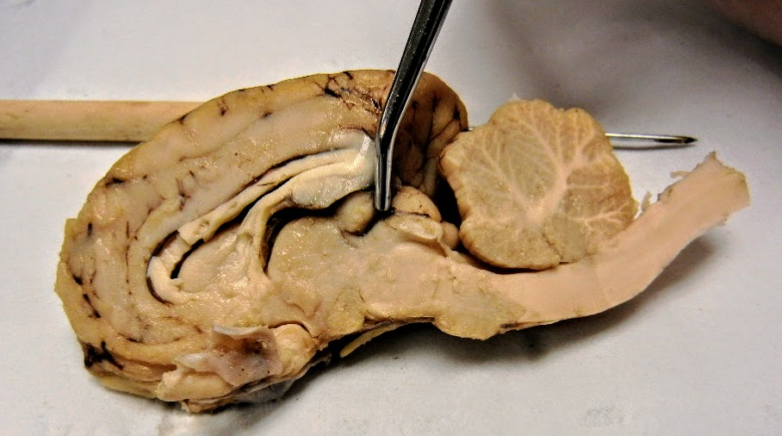
The pineal gland is visible in this internal view where the probe is located. Just behind the probe is the superior and inferior colliculi which you viewed in an earlier slide.
This image also shows the third ventricle which is located above the thalamus. A stretch of tissue called the fornix separates the lateral ventricle from the third ventricle.
11. Label the brain.
fornix
pineal gland
colliculi
third ventricle

Slide 13
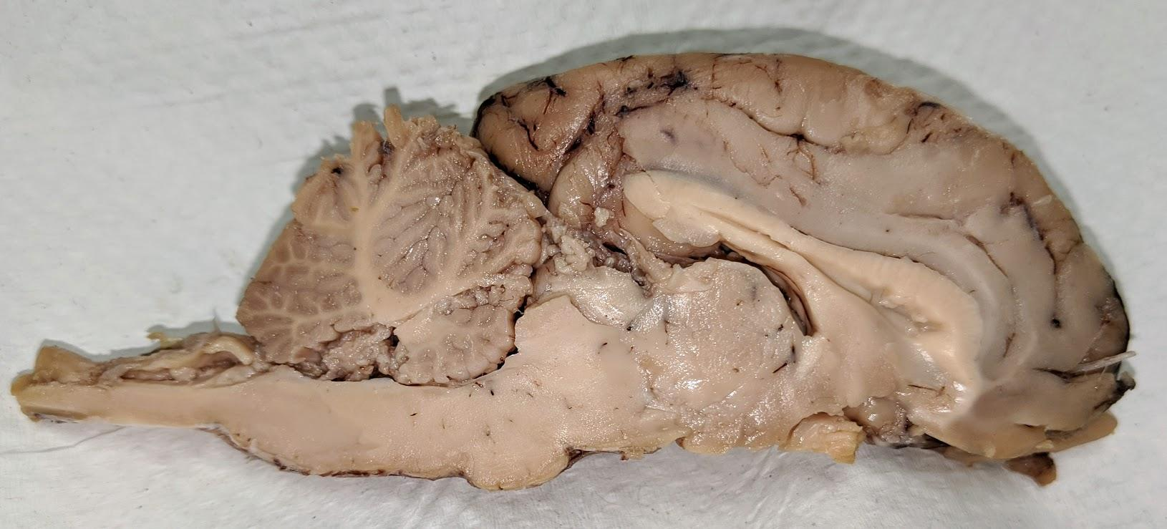
Take a closer look at the brainstem which has 3 main structures. Just behind the thalamus is the first section, called the midbrain. Then next part, which has a bulge that sticks out is the pons, followed by the medulla. The spinal cord is the section that begins just past the cerebellum.
This image also has a rare view (blue) of the pineal gland where it is attached to the hypothalamus.
12. Label the image.
pituitary
spinal cord
pons
medulla
midbrain

Slide 14
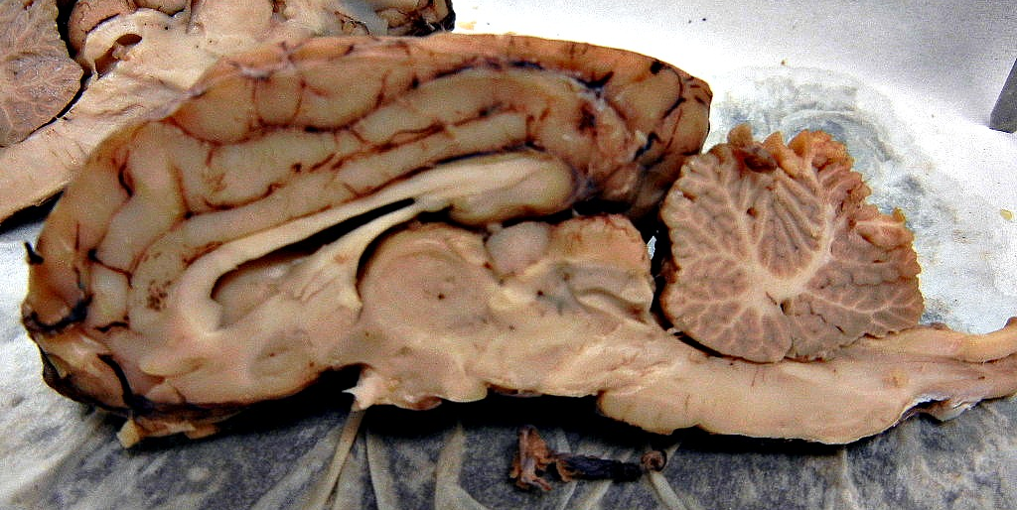
Show what you know!
13. The image has no arrows or labels. Use the arrow tool and the text tool to identify at least 6 structures on the brain.

Slide 15
corpus callosum
fornix
hypothalamus
pons
spinal cord
sulcus
thalamus
lateral ventricle
medulla
pineal gland
cerebellum
arbor vitae
pituitary

