Slide 1
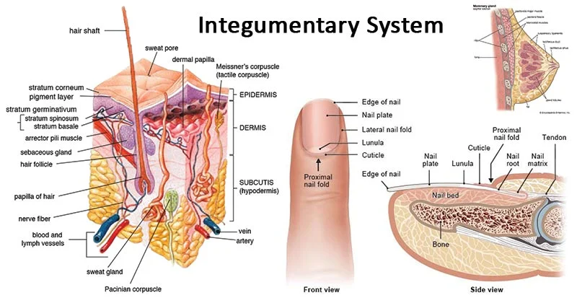

Slide 2
The Integumentary System
Also known as skin
Includes nails and hair
Has three distinct regions
Epidermis
Dermis
Hypodermis

Slide 3
Functions of skin
Protects
Cushions and insulates and is waterproof
Protects from chemicals, heat, cold, bacteria
Screens UV
Synthesizes vitamin D with UV
Regulates body heat
Prevents unnecessary water loss
Sensory reception (nerve endings)
Excrete waste

Slide 4
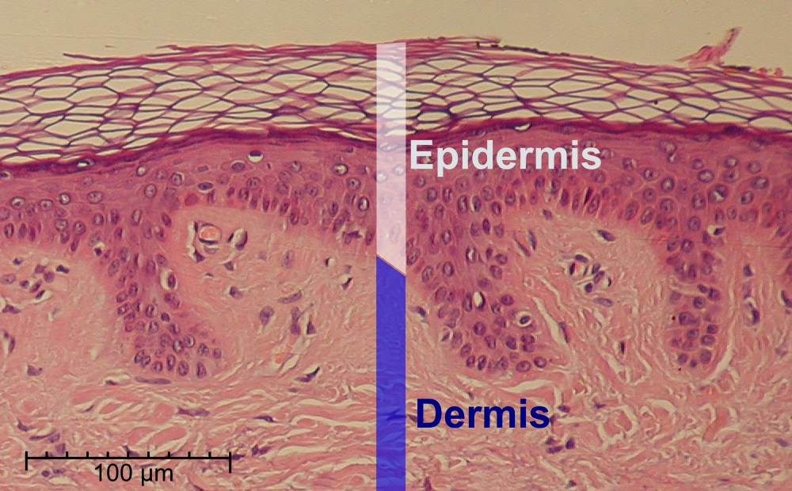
Epidermis- upper layer of skin
(see figure on next slide)

Slide 5
Types of cells in epidermis
Keratinocytes – deepest, produce keratin (tough fibrous protein)
Melanocytes - make dark skin pigment melanin
Merkel cells – associated with sensory nerve endings
Langerhans cells – macrophage-like dendritic cells

Slide 6
Layers of the epidermis (deep to superficial)
Stratum basale or germinativum – single row of cells attached to dermis; youngest cells; contains melanocytes
Stratum spinosum – resists tension
Stratum granulosum – layers of flattened keratinocytes producing keratin (hair and nails made of it also)
Stratum lucidum (only on palms and soles)
Stratum corneum – horny layer (cells dead, many layers thick)

Slide 7
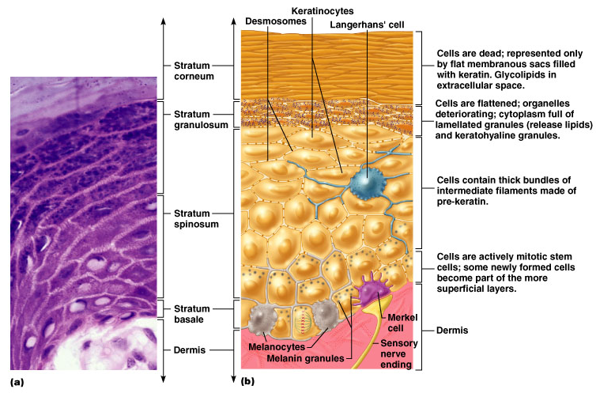
Epithelium: layers (on left) and cell types (on right)

Slide 8
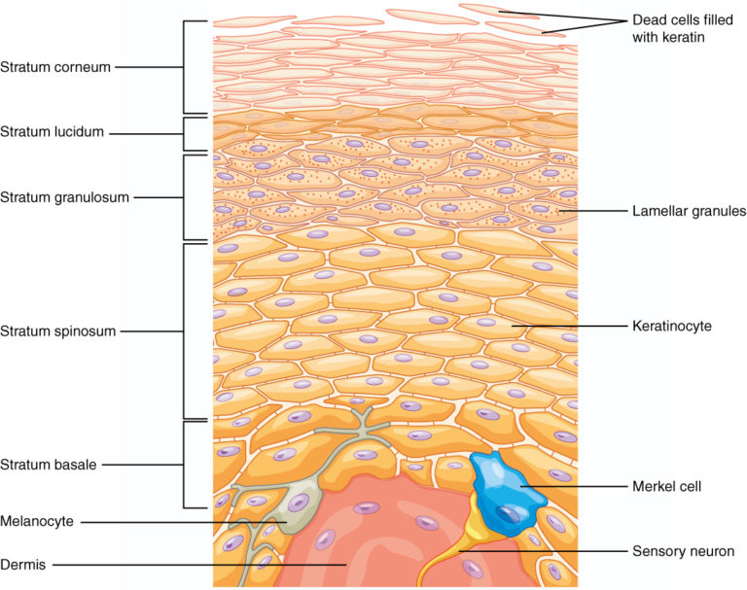

Slide 9
Skin color
Three skin pigments
Melanin: the most important, gives color to hair skin and eyes
Carotene: from carrots and yellow vegies
Hemoglobin: the pink of light skin
Melanin in granules passes from melanocytes (same number in all races) to keratinocytes in stratum basale

Slide 10
Dermis- under epidermis
Strong, flexible connective tissue: your “hide”

Slide 11
Composition of Dermis
Cells: fibroblasts, macrophages, mast cells, WBCs
Rich supply of nerves and vessels
Sweat glands
collagen, elastic, reticular fibers

Slide 12
Function of Dermis
Critical role in temperature regulation (the vessels)

Slide 13
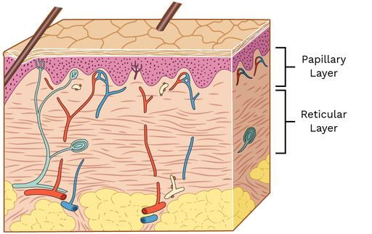
2 Layers of Dermis
Papillary – areolar connective tissue; includes dermal papillae
Reticular – “reticulum” (network) of collagen and reticular fibers
*bottom layer

Slide 14
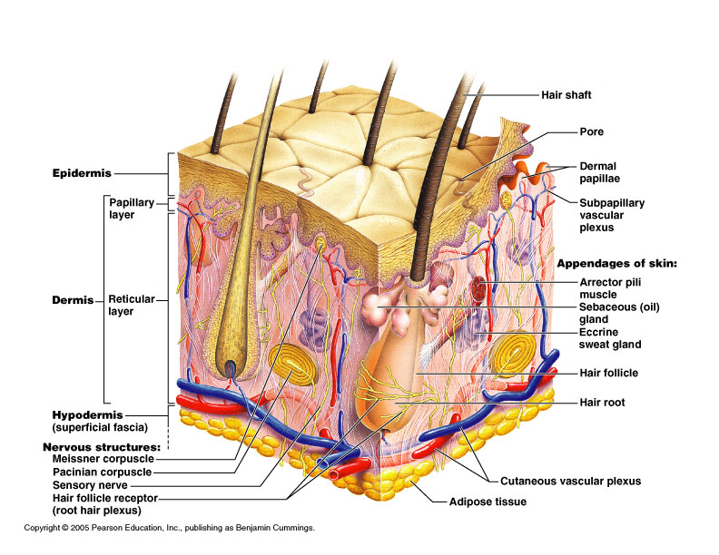
*Dermis layers
*Dermal papillae
*
*

Slide 15
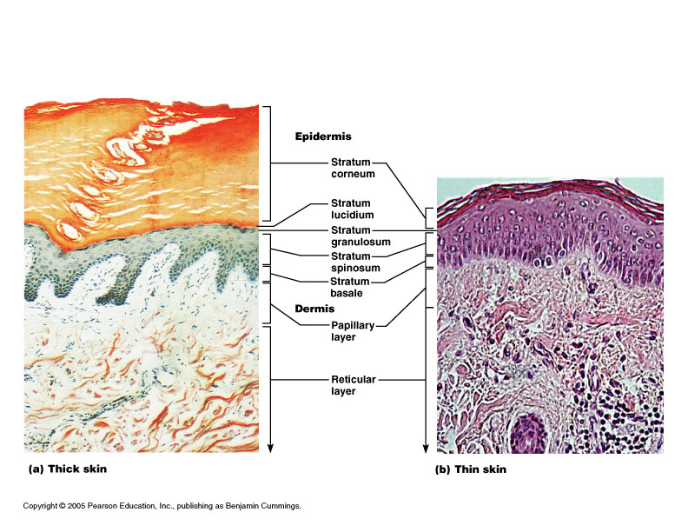
Epidermis and dermis of (a) thick skin and (b) thin skin
(which one makes the difference?)

Slide 16
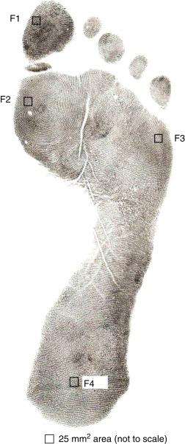
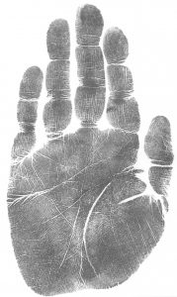
Fingerprints, palmprints, footprints
Dermal papillae lie atop dermal ridges
Elevate the overlying epidermis into
epidermal ridges
Are “sweat films” because of sweat pores
Genetically determined

Slide 17
Hypodermis
“Hypodermis” (Gk) = below the skin (subcutaneous)
Also called “superficial fascia”
“fascia” (Latin) =band; in anatomy: sheet of connective tissue
Fatty tissue which stores fat and anchors skin (areolar tissue and adipose cells)
Different patterns of accumulation
(male/female)

Slide 18
Skin appendages
Derived from epidermis but extend into dermis
Types
Hair and hair follicles
Sebaceous (oil) glands
Sweat (sudoiferous) glands
Nails

Slide 20
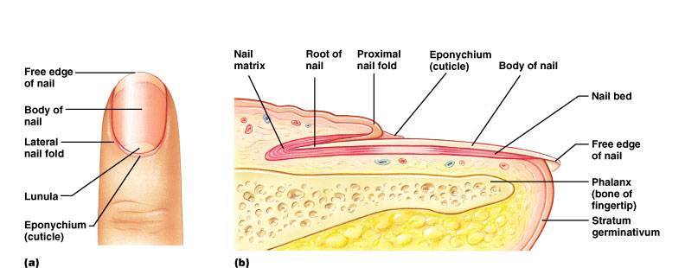
Nails
Made up of hard keratin
Corresponds to hooves and claws
Grows from nail matrix

Slide 21
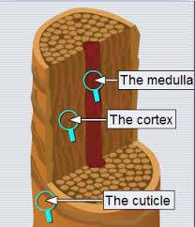
HAIR
Composition– hard keratin
Parts
Root imbedded in skin
Shaft projecting above skin surface
Three concentric layers
Medulla (core)
Cortex (surrounds medulla)
Cuticle (single layers, overlapping)

Slide 22
Everywhere but palms, soles of feet, nipples and parts of genitalia
Functions of hair
Warmth – less in man than other mammals
Sense light touch of the skin
Protection – scalp
arrector pili- smooth muscle that raises hair when cold or frightened
Grows an average of 2mm per week.

Slide 23
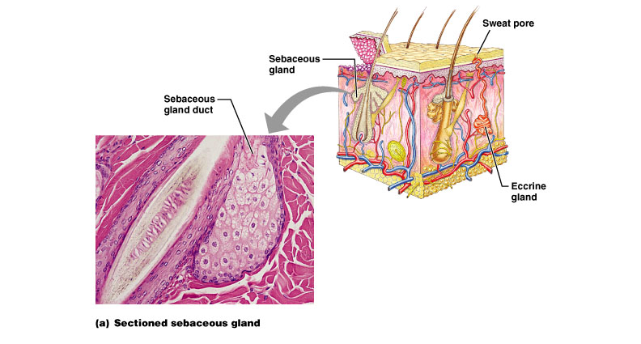
Sebaceous (oil) glands
Entire body except palms and soles
Produce sebum (fatty material and cellular debris)
Oils and lubricates

Slide 24
Sweat glands
Entire skin surface except nipples and part of external genitalia
Prevent overheating
500 cc to 12 l/day! (is mostly water)
Humans are the only mammals to have them
Produced in response to stress as well as heat

Slide 25
Types of sweat glands
Eccrine or merocrine
Most numerous
True sweat: 99% water, some salts, traces of waste
Open through pores
Apocrine
Axillary, anal and genital areas only
Ducts open into hair follices
The organic molecules in it decompose with time - odor
Modified apocrine glands
Ceruminous – secrete earwax
Mammary – secrete milk

Slide 26
Disorders of the integumentary system
Burns
Threat to life
Catastrophic loss of body fluids
Dehydration and fatal circulatory shock
Infection
Types
First degree – epidermis: redness (e.g. sunburn)
Second degree – epidermis and upper dermis: blister
Third degree - full thickness
Infections
Skin cancer

Slide 27
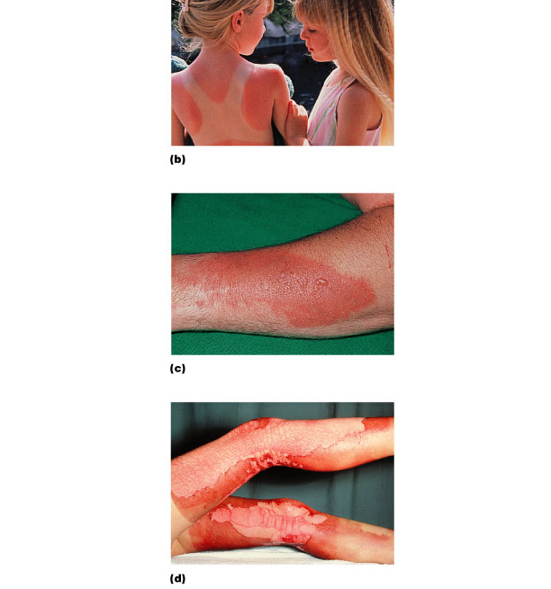
Burns
First-degree
(epidermis only; redness)
Second-degree
(epidermis and dermis,
with blistering)
Third-degree
(full thickness, destroying epidermis, dermis, often part of hypodermis)

Slide 28
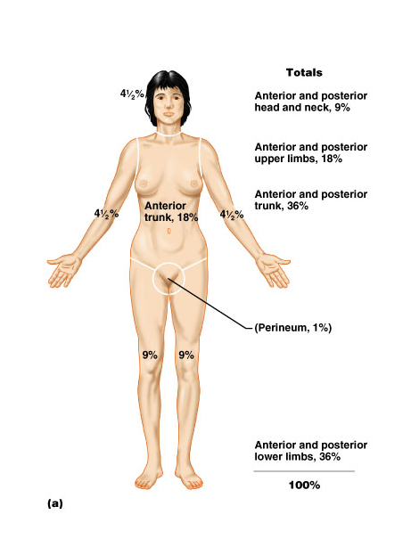
Critical burns
Estimate by “rule of 9’s”
Over 10% of the body has third-degree burns
25 % of the body has second-degree burns
Third-degree burns on face, hands, or feet

Slide 29
Tumors of the skin
Benign, e.g. warts
Cancer – associated with UV exposure (also skin aging)
Aktinic keratosis - premalignant
Basal cell - cells of stratum basale
Squamous cell - keratinocytes
Melanoma – melanocytes: most dangerous; recognition:
A - Asymmetry
B - Border irregularity
C - Colors
D - Diameter larger than 6 mm

Slide 30
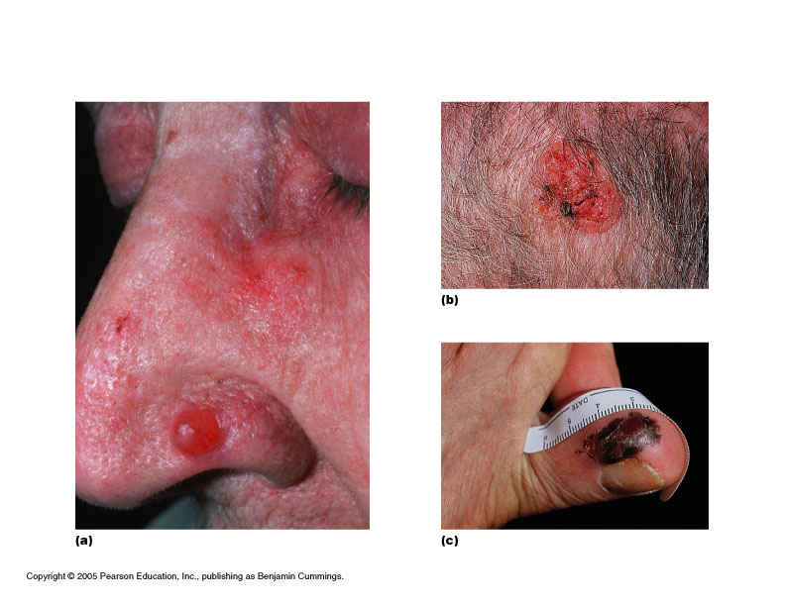
Skin Cancer
Sqaumous cell carcinoma
Basal cell carcinoma
Melanoma

