Slide 1
The Nervous System
0995457
Copyright © 2003 Pearson Education, Inc. publishing as Benjamin Cummings

Slide 2
Functions of the Nervous System
Senses stimuli (sensory)
2) Decides response to stimuli (integration)
3) Causes response to stimuli (motor)
Copyright © 2003 Pearson Education, Inc. publishing as Benjamin Cummings
Slide 7.1a

Slide 3
Structural Classification of the Nervous System
Central nervous system (CNS)- Brain and Spinal cord
Peripheral nervous system (PNS)- Nerve outside the brain and spinal cord
Copyright © 2003 Pearson Education, Inc. publishing as Benjamin Cummings
Slide 7.2

Slide 4
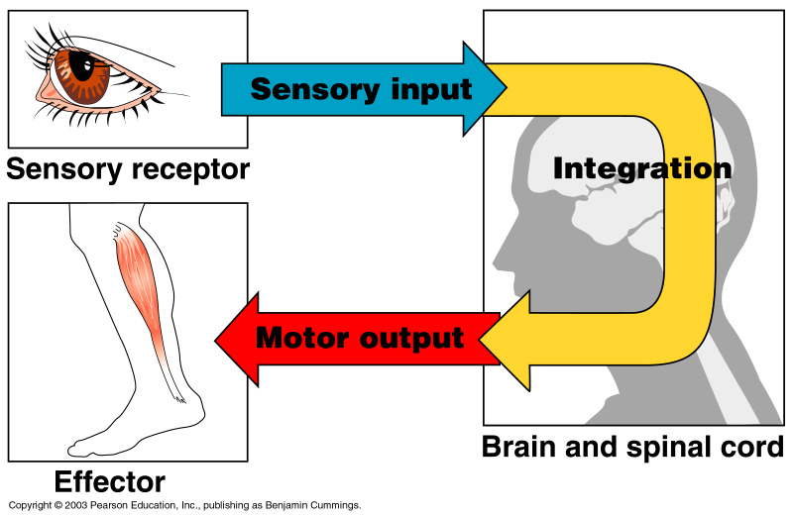
Sensory Division (Afferent)
Monitors changes occurring inside and outside the body (changes = stimuli)
2) Consists of nerve fibers that carry information to the central nervous system
Figure 7.1
Copyright © 2003 Pearson Education, Inc. publishing as Benjamin Cummings
Slide 7.3a

Slide 5
Motor Division (Efferent)
Causes response to stimuli
2. Consists of nerve fibers that carry impulses away from the central nervous system
Figure 7.1
Copyright © 2003 Pearson Education, Inc. publishing as Benjamin Cummings
Slide 7.3b

Slide 6
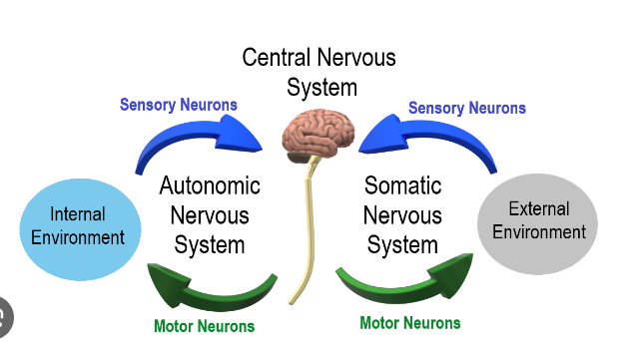
2 parts of Motor Division
Somatic nervous system = voluntary
2. Autonomic nervous system = involuntary
Figure 7.1
Copyright © 2003 Pearson Education, Inc. publishing as Benjamin Cummings
Slide 7.3c

Slide 7
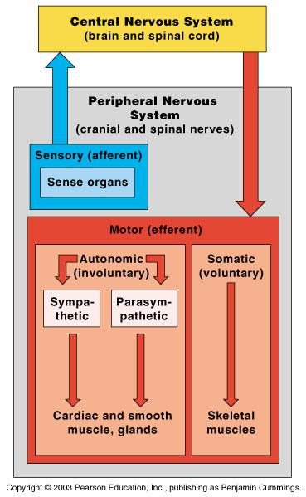
Organization of the Nervous System
Figure 7.2
Copyright © 2003 Pearson Education, Inc. publishing as Benjamin Cummings
Slide 7.4

Slide 8
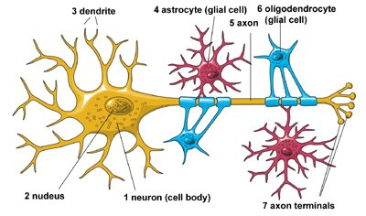
Main Types of Cells in Nervous System
Neurons- nerve cells, specialized to transmit messages
Neuroglia- support cells

Slide 9
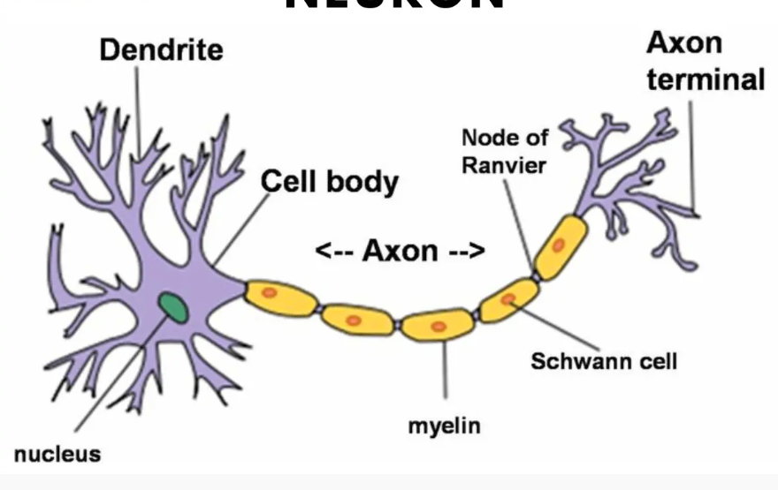
Typical Neuron

Slide 10
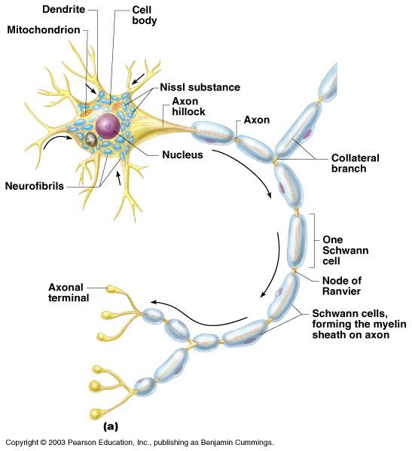
Multipolar Neuron Anatomy (most common)
1) Cell body
Nucleus
Large nucleolus
Metabolic center of cell
Figure 7.4a
Copyright © 2003 Pearson Education, Inc. publishing as Benjamin Cummings
Slide 7.9b

Slide 11
Multipolar Neuron Anatomy (Continued)
2) Dendrites – short processes that conduct impulses toward the cell body
3) Axons –long processes that conduct impulses away from the cell body (usually only 1!)
Figure 7.4a
Copyright © 2003 Pearson Education, Inc. publishing as Benjamin Cummings
Slide 7.10

Slide 12
Axons
1. Myelin Sheath- covering around axon.
2. Nodes of Ranvier- gaps in myelin sheath
3. Axonal terminals- end of axon
- contain vesicles with neurotransmitters - separated from the next neuron by a gap
Copyright © 2003 Pearson Education, Inc. publishing as Benjamin Cummings
Slide 7.11

Slide 13
Application
In Multiple Scleroses the myelin sheath is destroyed.
The myelin sheath hardens to a tissue called the scleroses.
This is considered an autoimmune disease.
Why does MS appear to affect the muscles?

Slide 14
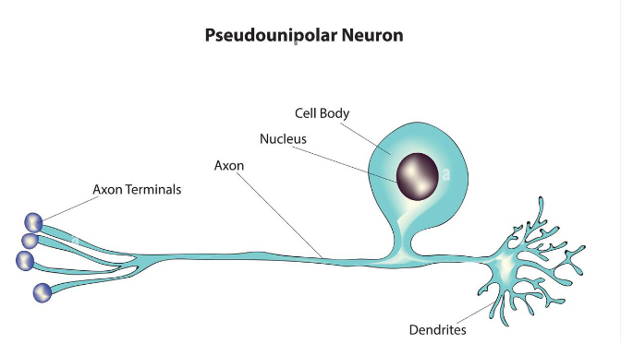
Functional Classification of Neurons
1) Sensory (afferent) neurons
Carry impulses from the sensory receptors
Proprioceptors – detect stretch or tension
Psuedounipolar
Copyright © 2003 Pearson Education, Inc. publishing as Benjamin Cummings
Slide 7.14a

Slide 15
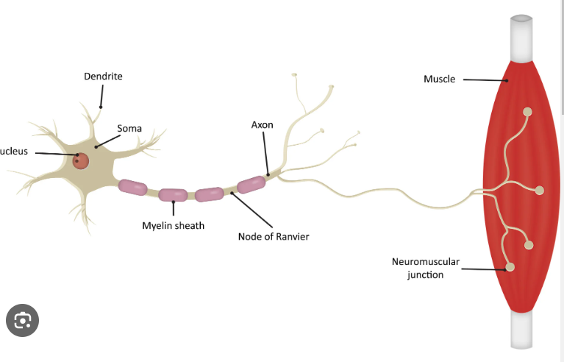
Functional Classification of Neurons (Cont.)
2) Motor (efferent) neurons
Carry impulses from the central nervous system
Multipolar (most common type)

Slide 16
Functional Classification of Neurons
3) Interneurons (association neurons)
-Found in neural pathways in the central
nervous system
-Connect sensory and motor neurons
Copyright © 2003 Pearson Education, Inc. publishing as Benjamin Cummings
Slide 7.14b

Slide 17
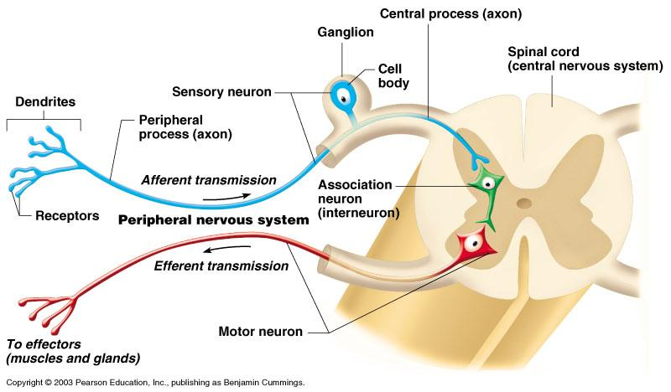
Neuron Classification
Figure 7.6
Copyright © 2003 Pearson Education, Inc. publishing as Benjamin Cummings
Slide 7.15

Slide 18
Nervous Tissue: Support Cells (Neuroglia or Glia)
1) Astrocytes
Abundant, star-shaped cells that brace neurons
Form barrier between capillaries and neurons
Figure 7.3a
Copyright © 2003 Pearson Education, Inc. publishing as Benjamin Cummings
Slide 7.5

Slide 19
Nervous Tissue: Support Cells
2) Microglia (CNS)
Spider-like phagocytes
Dispose of debris
3) Ependymal cells (CNS)
Line cavities of the brain and spinal cord
Circulate cerebrospinal fluid
Figure 7.3b, c
Slide 7.6
Copyright © 2003 Pearson Education, Inc. publishing as Benjamin Cummings

Slide 20
Nervous Tissue: Support Cells
4) Oligodendrocytes
(only in CNS)
Produce myelin sheath around nerve fibers in the central nervous system
Figure 7.3d
Copyright © 2003 Pearson Education, Inc. publishing as Benjamin Cummings
Slide 7.7a

Slide 21
Support Cells of the PNS
5) Satellite cells
Protect neuron cell bodies
6) Schwann cells
Form myelin sheath in the peripheral nervous system
Figure 7.3e
Copyright © 2003 Pearson Education, Inc. publishing as Benjamin Cummings
Slide 7.7b

Slide 22
Neuroglia vs. Neurons
Neuroglia divide, but neurons do not.
2) Most brain tumors are “gliomas.”, involving the neuroglia cells, not the neurons.

