Slide 1
Nervous System
Part 2
Transmitting an Impulse

Slide 2
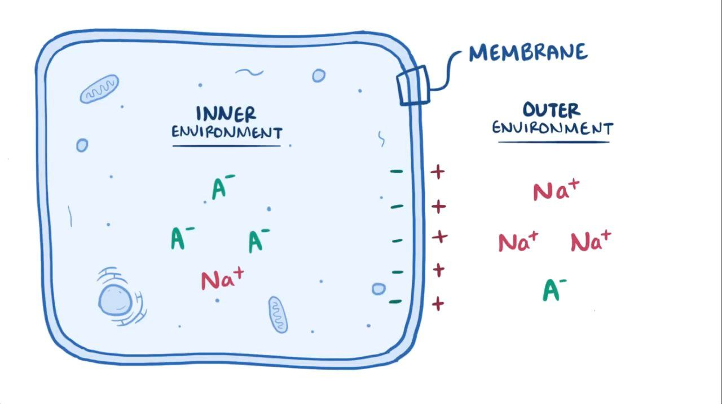
Neuron Cell Membrane at Rest
1) The inside is negative and the outside is positive
2) also known as polarized
3) Maintained by sodium-potassium pump

Slide 3
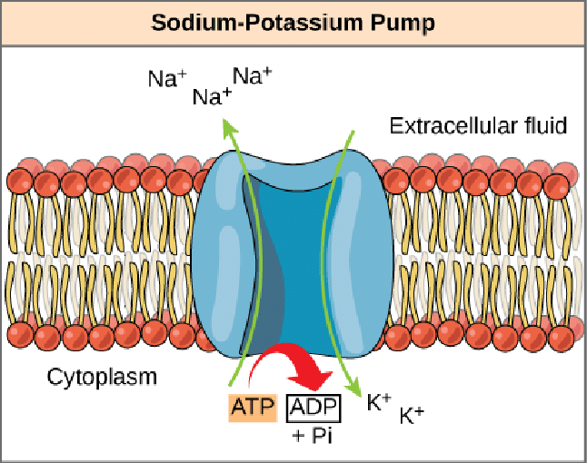
The sodium- potassium pump
Maintains resting membrane polarization (inside negative, outside positive)
requires ATP
Copyright © 2003 Pearson Education, Inc. publishing as Benjamin Cummings
Slide 7.19

Slide 4
Membrane During Action Potential (Impulse)
1) The inside of axon becomes positive instead of negative –CHARGE DISRUPTION!
2) This charge disruption is called depolarization
3) charge disruption travels down axon (ACTION POTENTIAL)

Slide 5
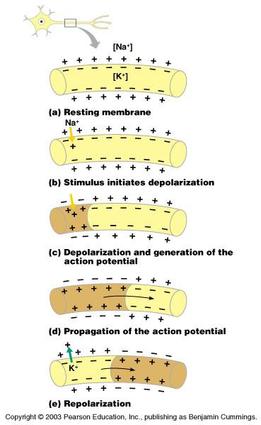
Steps of Action Potential
Sodium (Na⁺) gates open and Na+ flows inside of the axon, depolarizing the membrane
(inside becomes positive)
2) Then, potassium (K+) flows out (inside becomes negative again)
-also known as repolarization
Figure 7.9a–c
Copyright © 2003 Pearson Education, Inc. publishing as Benjamin Cummings
Slide 7.18

Slide 6
Steps of Action Potential (Cont.)
3) The impulse continues to move down neuron
Impulses travel faster when
fibers have a myelin sheath
Figure 7.9c–e
Copyright © 2003 Pearson Education, Inc. publishing as Benjamin Cummings
Slide 7.20

Slide 7
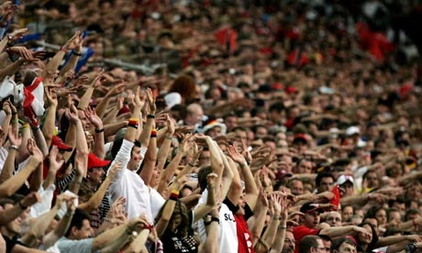
Hyperpolarization
The action potential moves like a wave in a stadium because right after it passes through, that part of the membrane can’t become depolarized right away

Slide 8
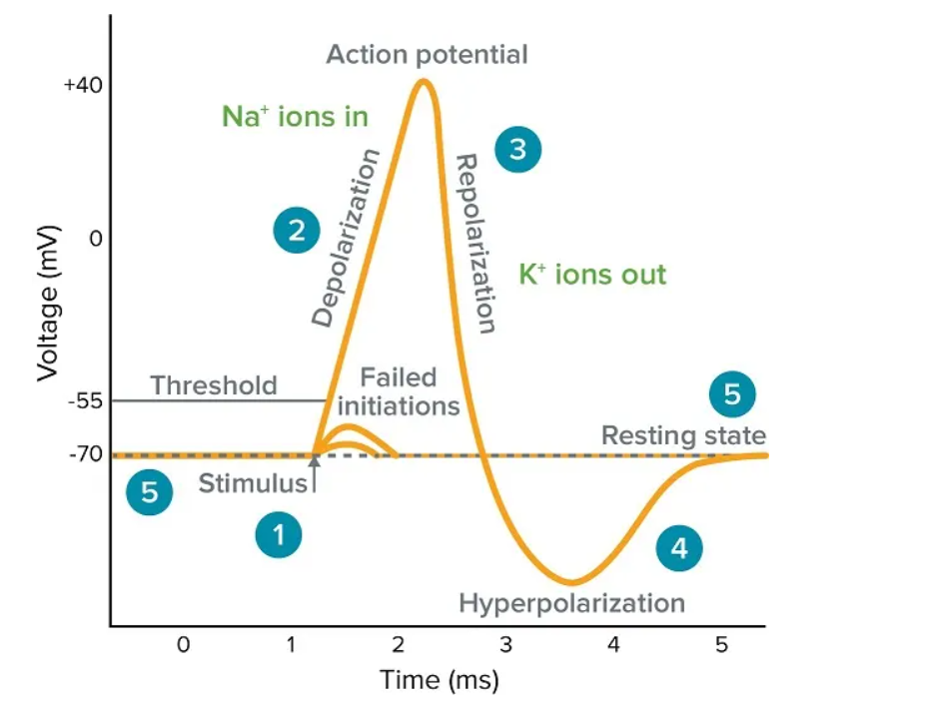

Slide 9
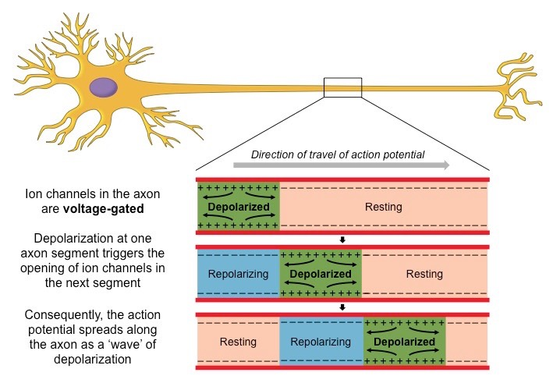

Slide 10
Nerve Impulse between Neurons
Action Potential reaches the axon terminal and causes neurotransmitter release
The dendrite of the next neuron has receptors that are stimulated by the neurotransmitter
An action potential is started in the dendrite
Copyright © 2003 Pearson Education, Inc. publishing as Benjamin Cummings
Slide 7.21

Slide 11
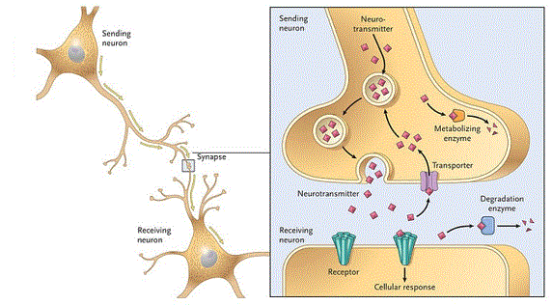
How Neurons Communicate at Synapses
Figure 7.10
Copyright © 2003 Pearson Education, Inc. publishing as Benjamin Cummings
Slide 7.22

Slide 12
Main Types of Neurotransmitters
1) Excitatory- increase likelihood of action potential
2) Inhibitory- decrease likelihood of action potential

Slide 13
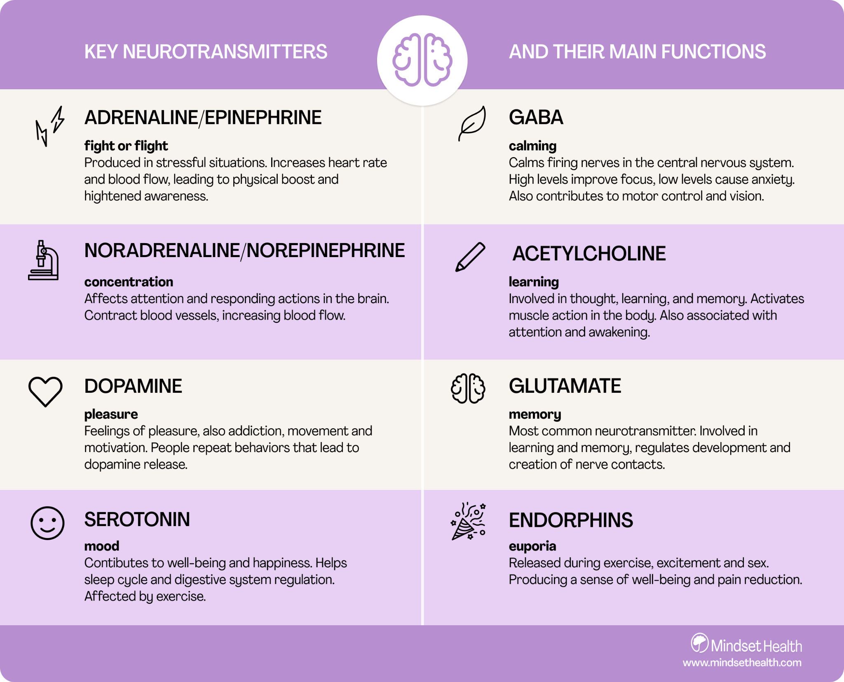

Slide 14
Somatic Nervous System
1) Stimulates skeletal muscles
2) voluntary
*Neurotransmitter- acetylcholine

Slide 15
Autonomic Nervous System
1) Sympathetic- “fight or flight”
*Neurotransmitters- norepinephrine,
epinephrine and acetylcholine
2) Parasympathetic- supports homeostasis
*Neurotransmitter- acetylcholine

