Slide 1
The Skeletal System

Slide 2
The Skeletal System
Parts of the skeletal system include:
Bones (skeleton)
Joints
Cartilages
Ligaments
Divided into two divisions:
Axial skeleton (skull, ribs and vertebra)
Appendicular skeleton (pelvis, extremities)

Slide 3
Functions of Bones
Support of the body
Protection of soft organs
Movement due to attached skeletal muscles
Storage of minerals and fats
Blood cell formation

Slide 4
ORGANIZATION
About 206 bones

Slide 5
Axial Skeleton
Head, neck, trunk
Skull
Hyoid Bone
Vertebral Column
Thoracic Cage (ribs, 12 pairs)
Sternum

Slide 6
Hyoid Bone

Slide 7
Appendicular Skeleton
Limbs & Bones that connect to the
Pectoral Girdle (shoulders)
Pelvic Girdle (hips)

Slide 8
Bone Tissue
Two basic types of bone tissue
Compact bone
Homogeneous
Spongy bone
Small needle-like pieces of bone
Many open spaces
Figure 5.2b

Slide 9
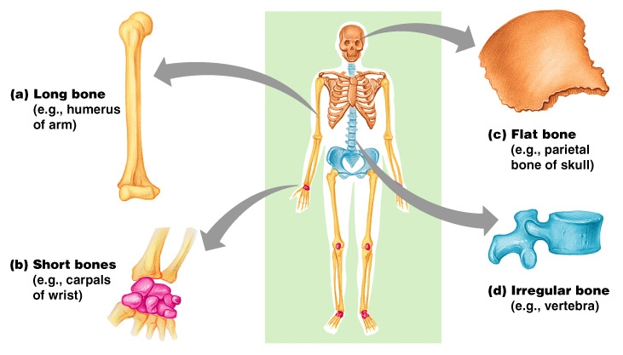
Classification of Bones on the Basis of Shape
Figure 5.1

Slide 10
Bone Shapes
Long bones
Typically longer than wide
Have a shaft with heads at both ends
Contain mostly compact bone
Examples: Femur, humerus
Short bones
Generally cube-shape
Contain mostly spongy bone
Examples: Carpals, tarsals

Slide 11
Bone Shapes (cont.)
Flat bones
Thin and flattened, usually curved
Thin layers of compact bone around a layer of spongy bone
Examples: Skull, ribs, sternum
Irregular bones
Irregular in shape
Do not fit into other bone classification categories
Example: Vertebrae and hip

Slide 12
Gross Anatomy of a Long Bone
Diaphysis
Shaft
Composed of compact bone
Epiphysis
Ends of the bone
Composed mostly of spongy bone

Slide 13
Gross Anatomy of a Long Bone
Periosteum
Outside covering of the diaphysis
Fibrous connective tissue membrane
Sharpey’s fibers
Secure periosteum to underlying bone
Arteries
Supply bone cells with nutrients
Figure 5.2c

Slide 14
Gross Anatomy of a Long Bone
Articular cartilage
Covers the external surface of the epiphyses
Made of hyaline cartilage
Decreases friction at joint surfaces
Figure 5.2a

Slide 15
Gross Anatomy of a Long Bone
Medullary cavity
Cavity of the shaft
Contains yellow marrow (mostly fat) in adults
Contains red marrow (for blood cell formation)
** only type found in infants

Slide 16
Structure of a Long Bone
Figure 6.3a-c

Slide 17
* Assignment
– Coloring of a Long Bone

Slide 18
Review the Structure of a Long Bone
Matching quiz at http://www.mhhe.com/biosci/ap/holehaap/student/olc2/chap07matching01.html

Slide 19
Bone Markings
Types:
1) Projections and processes – grow out from the bone surface
2) Depressions or cavities – indentations
Functions:
1) Sites of attachments for muscles, tendons, and ligaments
2) Passages for nerves and blood vessels

Slide 20
Microscopic Anatomy of Bone

Slide 22
Microscopic Structure
MATRIX - where the bone cells live, made up of collagen and inorganic salts
OSTEOCYTES - mature bone cells, enclosed in tiny chambers called LACUNAE
LAMELLAE- rings of osteocytes
HAVERSIAN CANAL, center of the rings, houses blood vessels
CANALICULI- passageways that link osteocytes
VOLKMAN's CANALS- link Haversion canals.
OSTEONS- a Haversian Canal and the lamellae that surround it

Slide 23
Test Yourself
Find the...
Haversian Canal
Volkman's Canal
Lamellae
Spongy Bone
Compact Bone

Slide 25
BONE DEVELOPMENT & GROWTH
ALL BONES START AS HYALINE CARTILAGE, areas gradually turn to bone
PRIMARY OSSIFICATION CENTER (shaft)
SECONDARY OSSIFICATION CENTER (ends)

Slide 26
Bone Growth
Bones are remodeled and lengthened until growth stops
Bones change shape somewhat
Bones grow in width

Slide 27
Long Bone Formation and Growth
Figure 5.4b

Slide 28
Bone Development & Growth
EPIPHYSEAL DISK (growth plate) is a band of cartilage between the epiphysis and diaphysis
These areas increase bone length as the cells ossify
Cartilage becomes OSTEOBLASTS become OSTEOCYTES

Slide 29
Types of Bone Cells
Osteocytes
Mature bone cells
Osteoblasts
Bone-forming cells
Osteoclasts
Bone-destroying cells
Break down bone matrix for remodeling and release of calcium
Bone remodeling is a process by both osteoblasts and osteoclasts

Slide 30
Bone Remodeling

