Slide 1
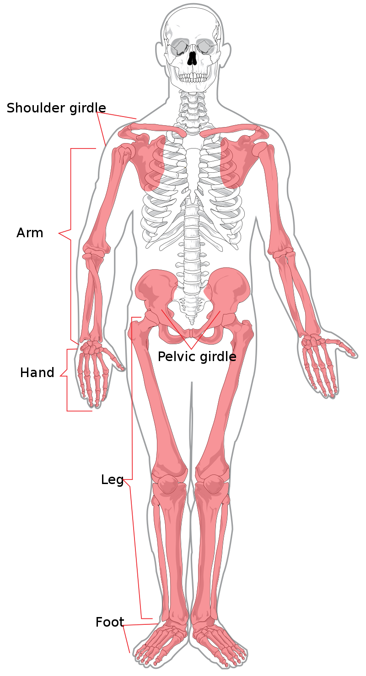
The Appendicular Skeleton
Limbs (appendages)
Pectoral girdle
Pelvic girdle

Slide 2
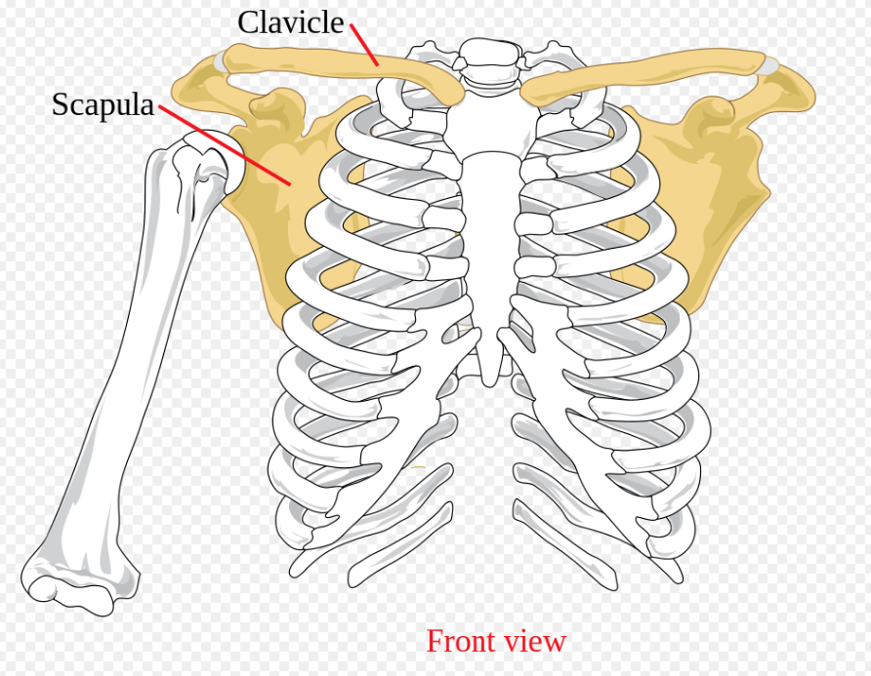
The Pectoral (Shoulder) Girdle
Composed of two bones
Clavicle – collarbone
Scapula – shoulder blade
These bones allow the upper limb
to have exceptionally free movement

Slide 3
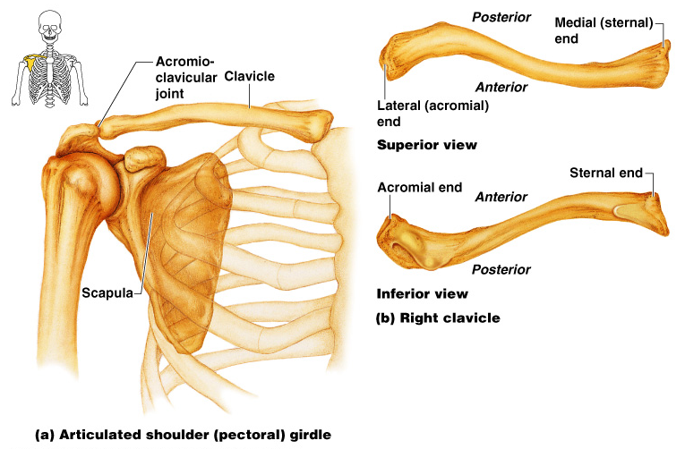
Bones of the Pectoral Girdle
Figure 5.20a–b

Slide 4
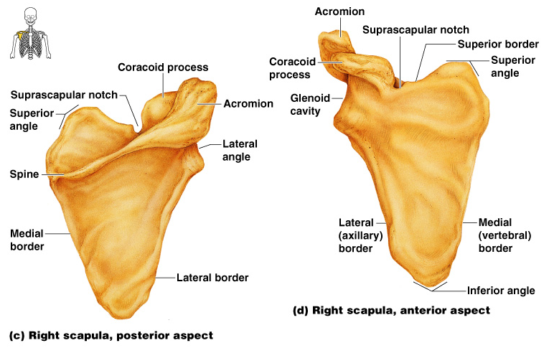
Bones of the Shoulder
Figure 5.20c–d

Slide 5
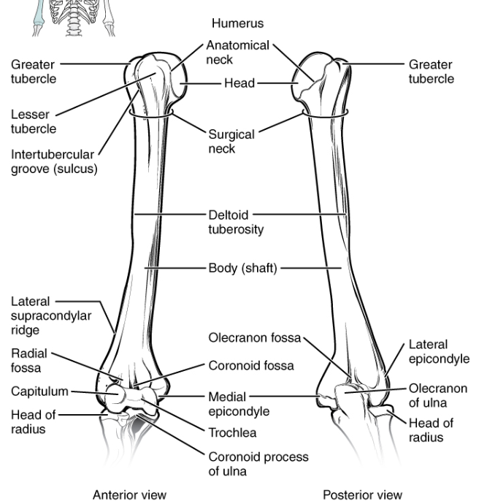
Humerus- upper arm
Figure 5.21a–b

Slide 6
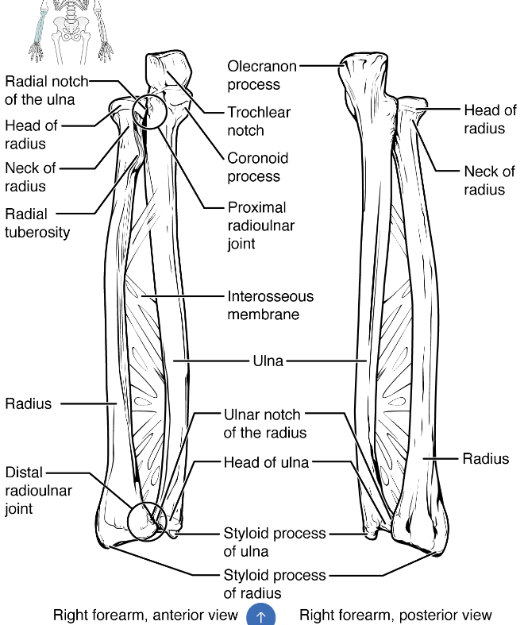
Forearm Bones
Radius- on thumb side
Ulna- forms elbow joint

Slide 7
Bones of the Upper Limb
The hand
Carpals – wrist
Metacarpals – palm
Phalanges – fingers
Figure 5.22

Slide 8
Bones of the Pelvic Girdle
Hip bones
Composed of three pair of fused bones
Ilium
Ischium
Pubic bone
The total weight of the upper body rests on the pelvis
Protects several organs
Reproductive organs
Urinary bladder
Part of the large intestine

Slide 9
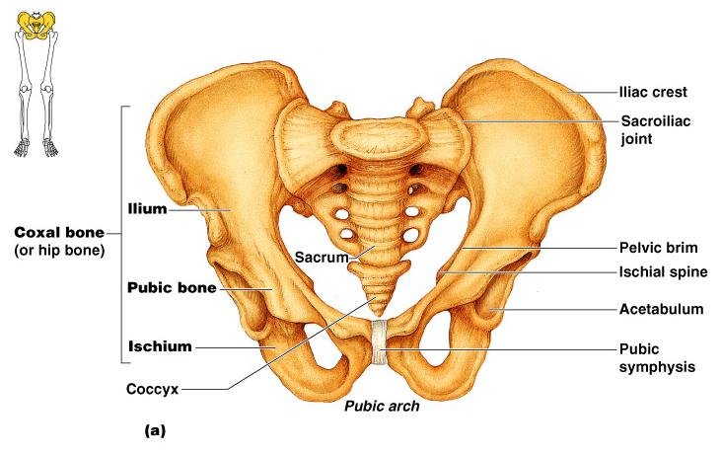
The Pelvis
Figure 5.23a

Slide 10
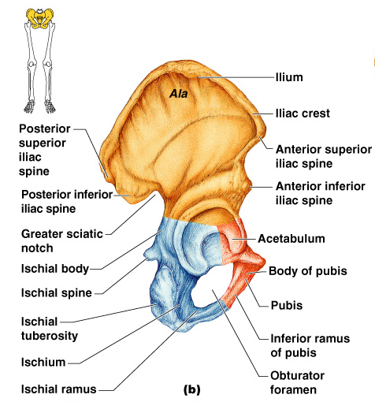
The Pelvis: Right Coxal Bone
Figure 5.23b

Slide 11
Gender Differences of the Pelvis
Figure 5.23c

Slide 12
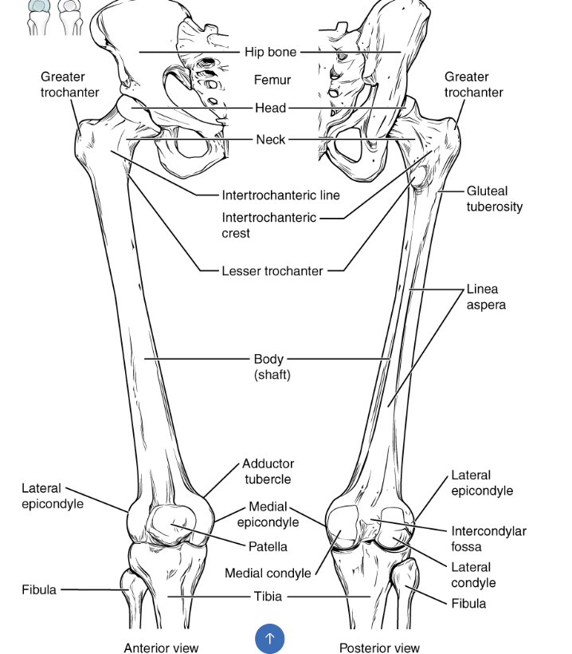
Femur- forms thigh

Slide 13
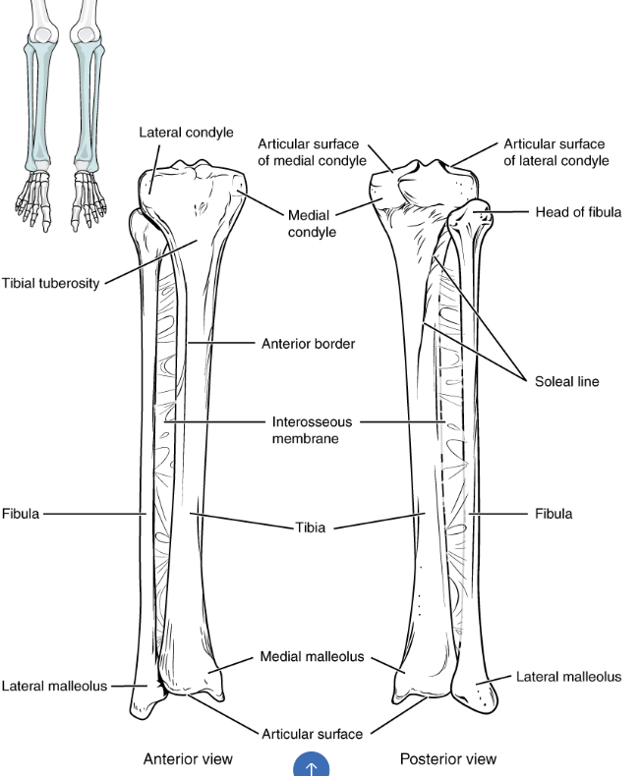
Lower Leg Bones
Tibia- larger, medial
Fibula- skinny
Figure 5.24c

Slide 14
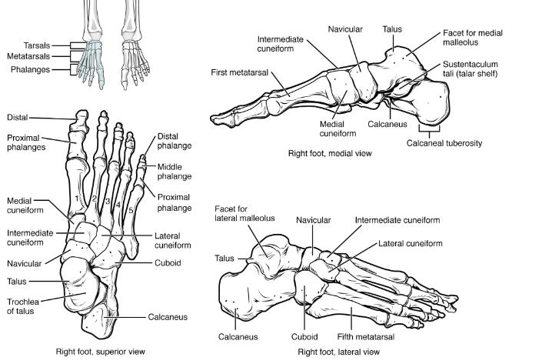
Bones of the Lower Limbs
The foot
Tarsals – ankle
Metatarsals
Phalanges – toes
Figure 5.25

