Slide 1
Tissues

Slide 2
And this type.....

Slide 3
General Characteristics of Epithelial Tissue
1) Found throughout the body, covers all body surfaces both inside and out.
2) Main glandular tissue.
3) Attached to underlying connective tissue by noncellular nonliving basement membrane.
4) Usually has no vascular tissue - blood supply
5) Cells reproduce rapidly (rapid healing).
6) Cells tightly packed together

Slide 4
Where does all the dead skin you shed go?
It takes about 27 days for the outer layer of skin to shed and be replaced; that works out to 1.5 pounds of skin cells per year.

Slide 5
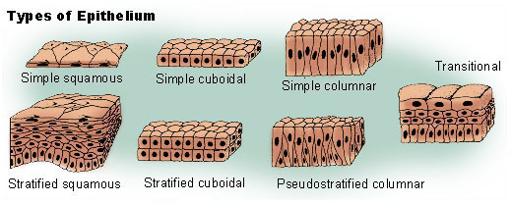
Types of Epithelial Cells
We will be learning 8 different types of epithelial cells.
Named for the number of layers and the shape of the cells.

Slide 6
Epithelial tissue is named based on its description
simple = single layer
stratified = multiple layers
squamous = flat
cuboidal = square
columnar = column (rectangle)
pseudo= false

Slide 8
Simple Squamous
Description: thin, flattened cells
Function: quick diffusion and filtration.
Location: Air sacs in lungs, walls of capillaries

Slide 10
Simple Cuboidal
Description: single layer of cube-shaped cells
Function: secretion and absorption
Location: kidneys tubules, ducts and covering the ovaries

Slide 12
Simple Columnar
Description: single layer of column shaped cells (taller than they are wide
Function: secretion and absorption
Location: Found in Digestive tract and uterus
*Contains goblet cells to secrete mucus
*Can have cilia and microvilli

Slide 14
Stratified Squamous
Description: many layers with flat cells at the top
Function: protection
Location: top layer of skin and lining of mouth

Slide 15
The ink of tattoos must be injected below the basement membrane.

Slide 16
Tissues often come in layers on the body - superficial cuts on the skin may need to be stitched if they also go through the underlying tissue.
This will definitely need stitches!

Slide 17
Stratified cuboidal epithelium
Description: multiple layers of cube-shaped cells
Function: secretion and protection
Location: line sweat and salivary glands

Slide 18
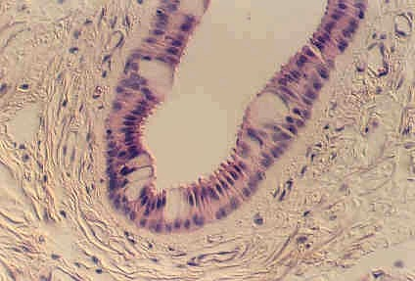
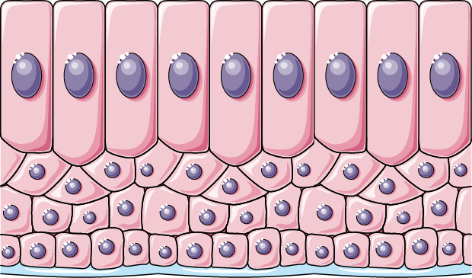
Stratified Columnar Epithelium
Description: Top layers are column-shaped
(columnar) and bottom layers are
cube- shaped (cuboidal)
Function: protection and secretion
Location: male urethra, larger ducts of glands

Slide 19
Pseudostratified Columnar
Single layer, nuclei are uneven which gives it a layered appearance
Can have goblet cells and cilia
Protect and filter
Location: lining air passages and tubes of the reproductive system

Slide 21
Transitional Epithelium
Description: several layers of irregular-shaped cells
Function: Blocks diffusion (no leaking)
Location: urinary bladder

Slide 22
Identify the tissues

Slide 24
Connective Tissue

Slide 25
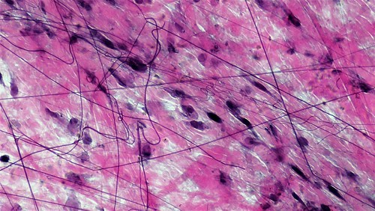
Connective Tissue General Characteristics
-Most abundant tissue in your body, found throughout
-Binds structures together
-Cells can reproduce

Slide 26
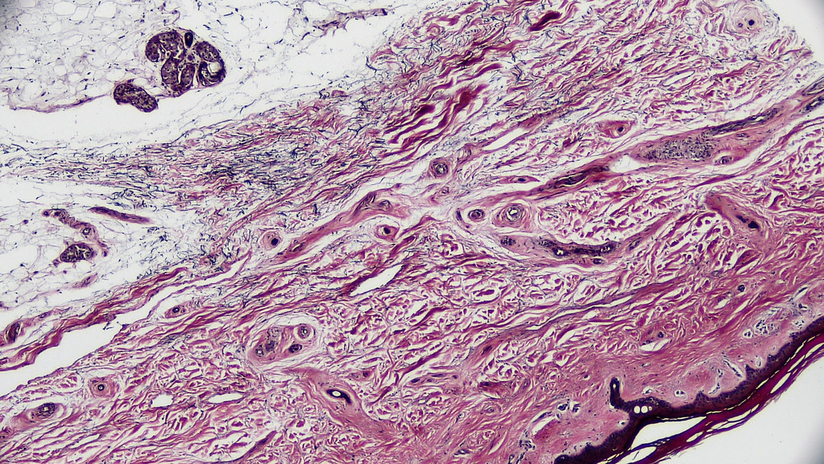
Connective Tissue Function
-Provides support, protection, framework, fills space, stores fat, produces blood cells, fights infection, and helps repair tissue.

Slide 27
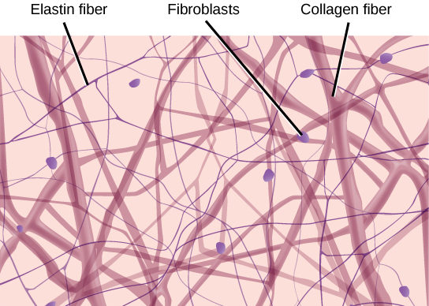
Connective Tissue Composition
-Composed of more scattered cells, fibers, and ground substance (fluid or semi-fluid between cells and fibers)
-Most have a good blood supply
This Photo by Unknown Author is licensed under CC BY

Slide 28
Types of Cells in Connective Tissue
Mast cells (prevents clots)
Macrophages (consumers)
Fibroblasts (produce fibers)

Slide 31
Main types of Fibers
Collagenous fibers - strong and flexible
bones, tendons and ligaments
Elastic fibers - very flexible, ears and vocal cords

Slide 33
Loose Connective Tissue or Areolar Tissue
Binds underlying organs to skin and to each other
Semi-liquid matrix with sparse fibers
Forms delicate thin membranes throughout the body

Slide 35
Adipose Tissue (fat)
-Looks like honeycomb
-Stores energy

Slide 36
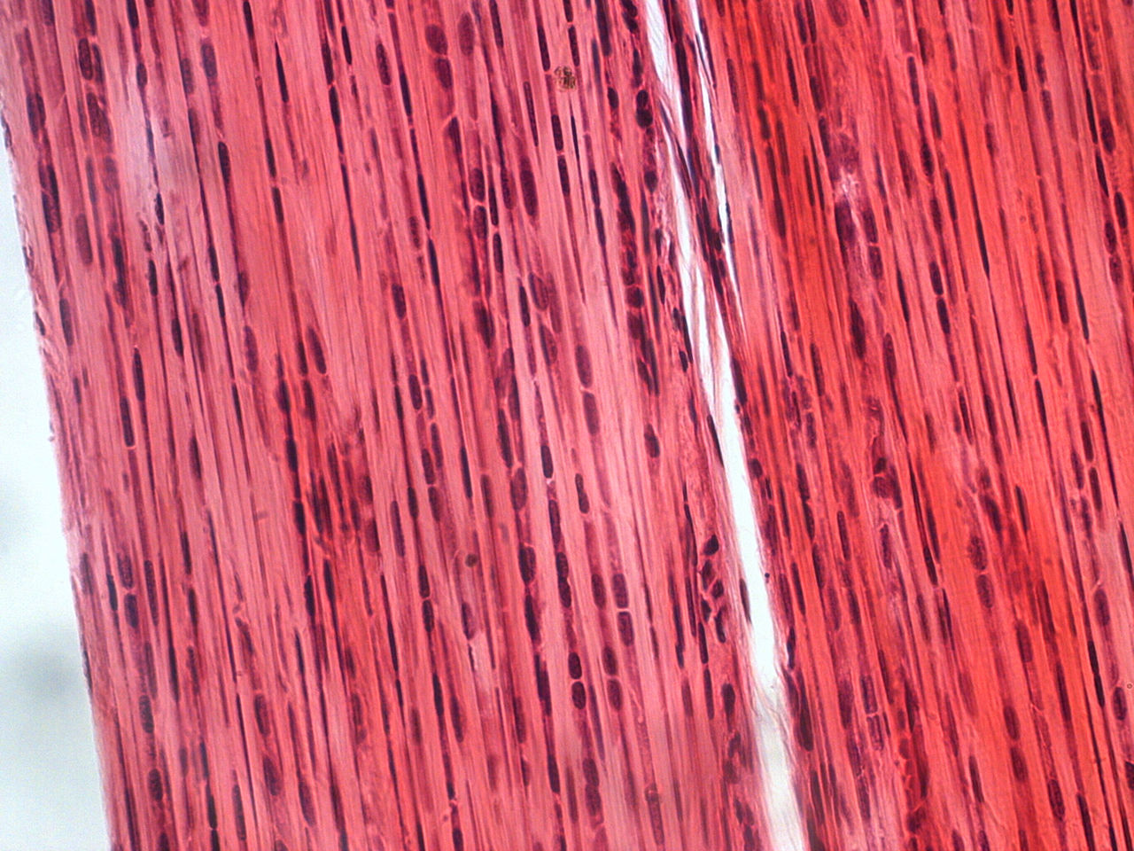
Dense Fibrous Connective Tissue
- Has packed collagen fibers
-Examples:
Tendons = muscles to bones
Ligaments = bones to bones

Slide 38
CARTILAGE
Provides support and attachments, also cushions bones
Contains Cartilage cells called chondrocytes
3 Different types:
Hyaline, elastic, fibrocartilage

Slide 39
Hyaline Cartilage
Covers ends of joints, nose and respiratory passages

Slide 40
Hyaline cartilage

Slide 41
Hyaline cartilage

Slide 42
Elastic cartilage
External Ear and Larynx

Slide 43
Fibrocartilage
Tough, shock absorbing

Slide 44
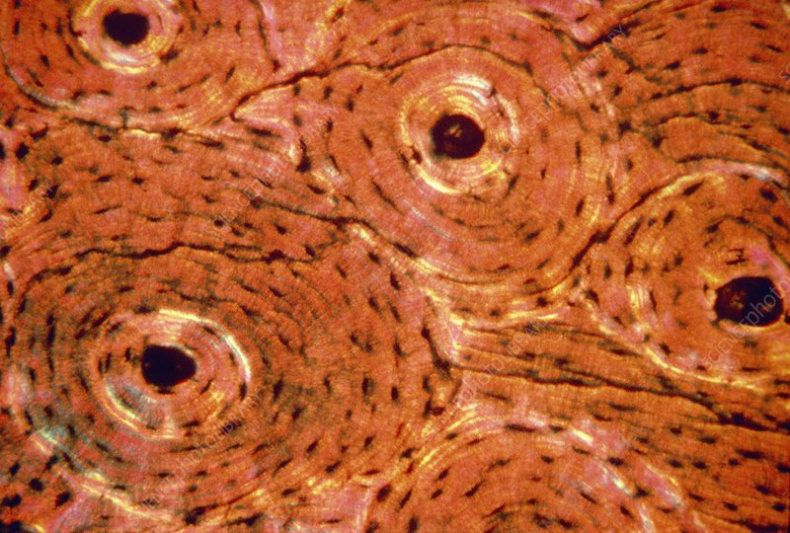
Bone Tissue (Osseus)
Makes up skeleton
Forms blood cells
Hard, contains calcium

Slide 45
Blood Tissue
Transports nutrients
Fights infection

Slide 46
Muscle Tissue

Slide 47
Cardiac muscle
Forms heart
Involuntary
Has stripes

Slide 48
Skeletal muscle
Moves bones
Voluntary
Has stripes

Slide 49
Smooth muscle
Pushes food through digestive tract
Involuntary
No stripes

Slide 50
Nerve Tissue
Transmits signals
Responds to environment

Slide 51
Nervous tissue (spinal cord)

